Slide 1
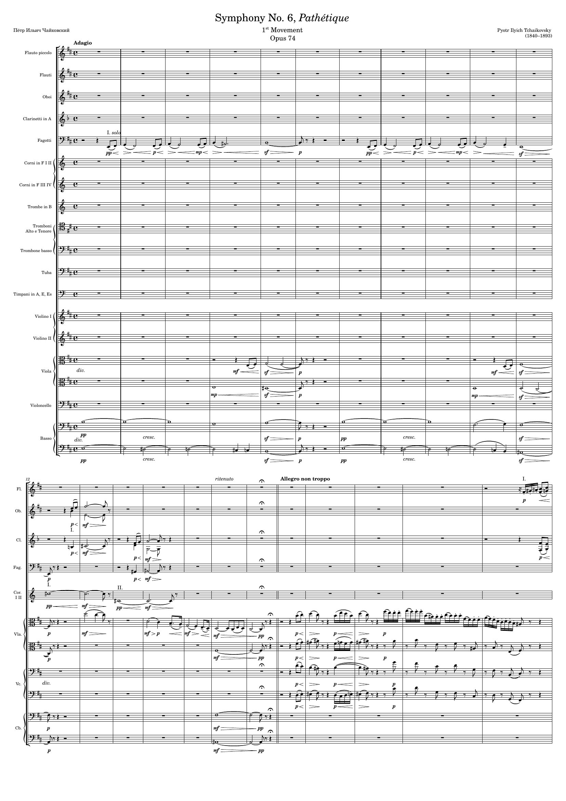
mel
harm
－
harm
－
harm
－
harm
－
mel
mel
harm
－
harm
－
mel
harm
－
harm
－
harm
－
mel
harm
－
rhythm+harm
harm
－
rhythm+harm
harm
－
rhythm+harm
harm
－
harm
－

Slide 2
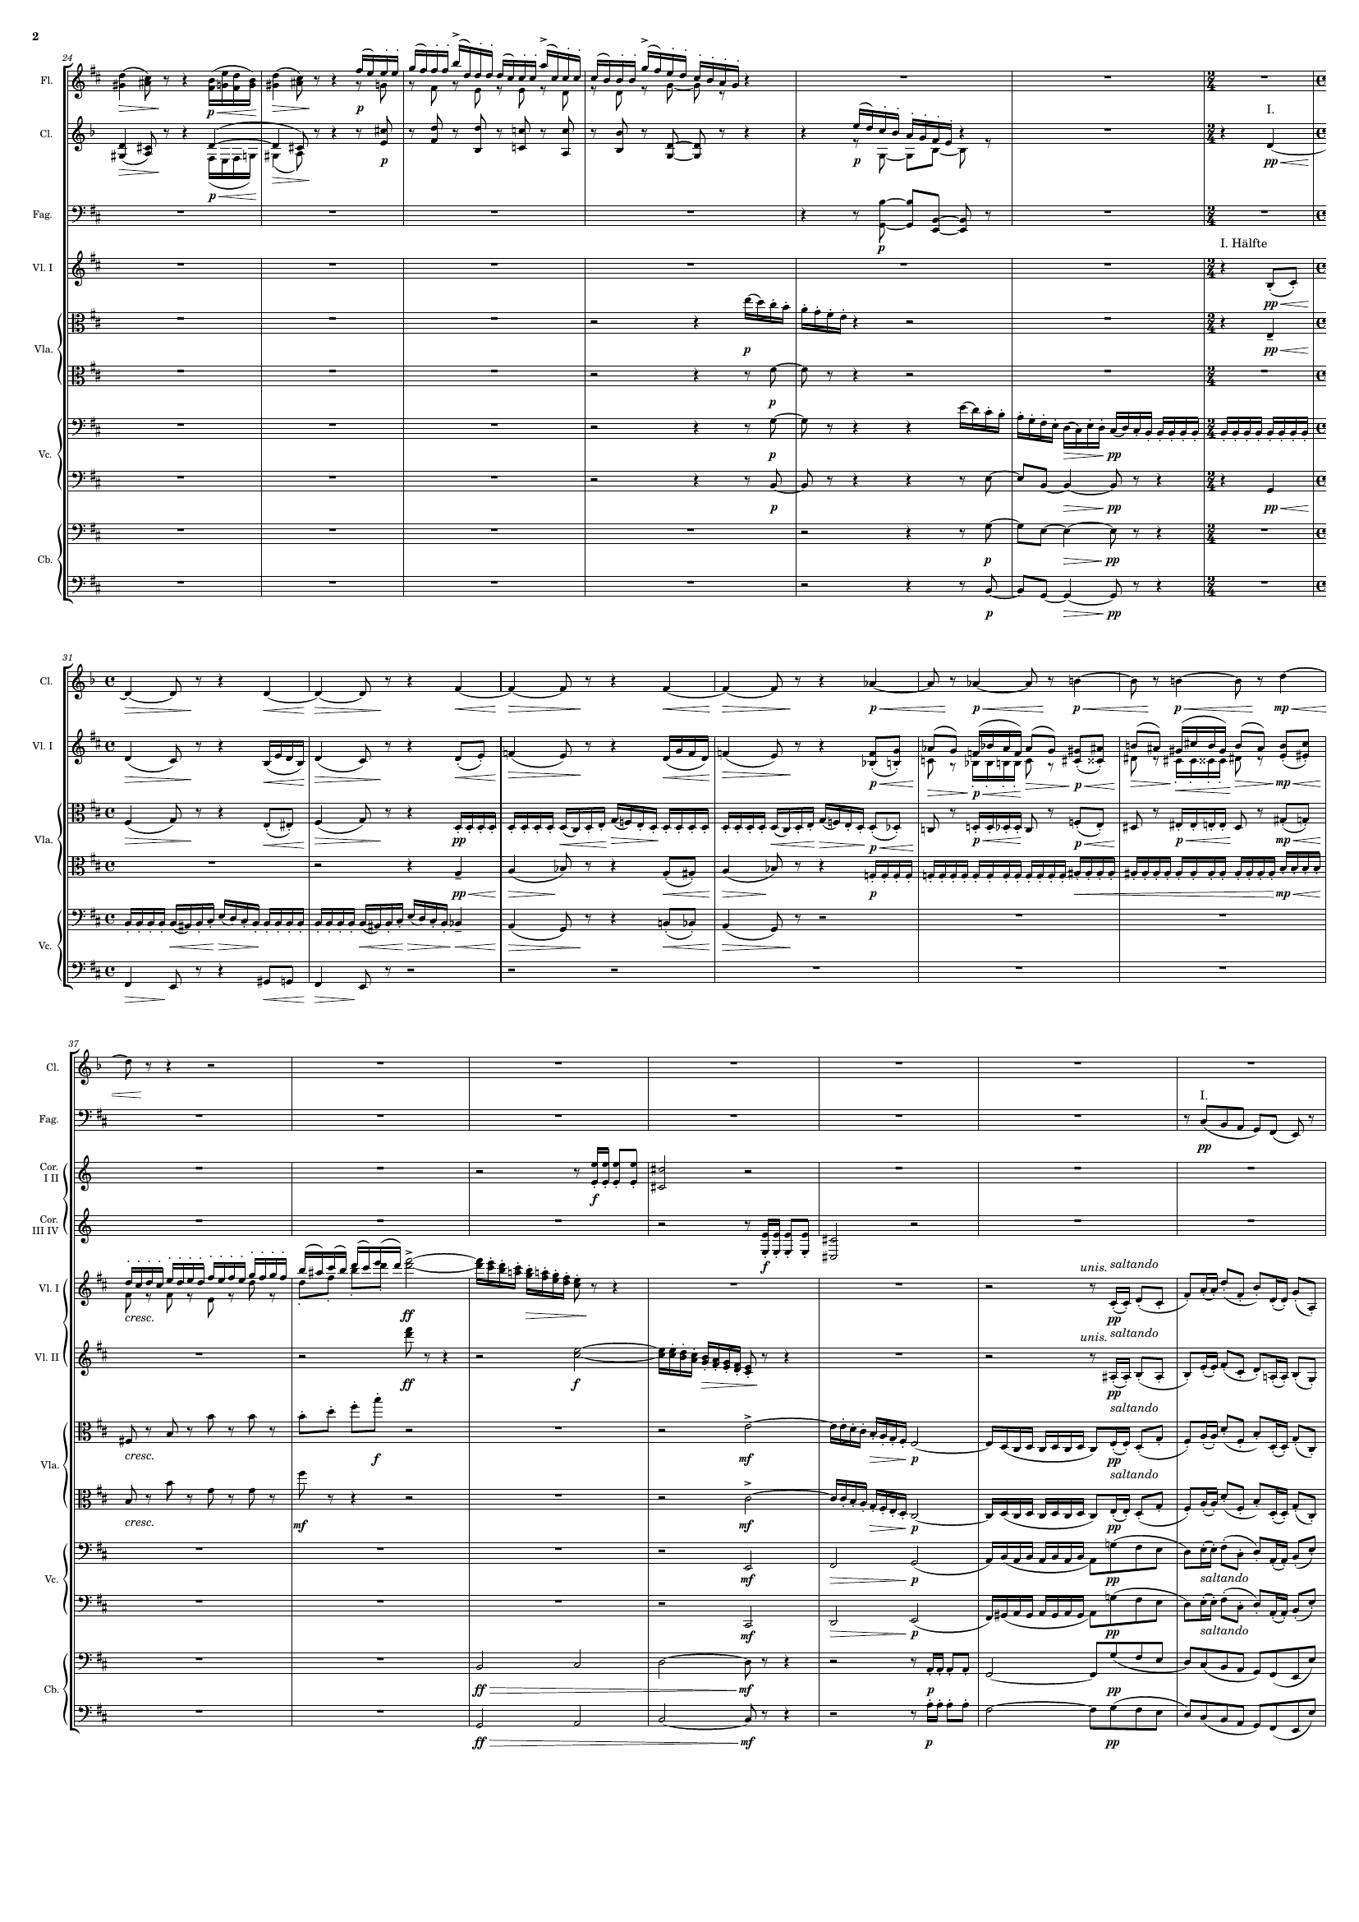
mel
mel
harm
rhythm+harm
mel
rhythm+harm
rhythm+harm
rhythm+harm
mel
mel
rhythm+harm
rhythm+harm
rhythm+harm
rhythm+harm
rhythm+harm
rhythm+harm
rhythm+harm
rhythm+harm
rhythm+harm
rhythm+harm
mel
rhythm+harm
rhythm+harm
rhythm+harm
rhythm+harm
rhythm+harm
rhythm+harm
harm
rhythm+harm
mel
mel+rhythm
mel
rhythm+harm
rhythm+harm
mel
rhythm+harm
rhythm+harm
mel
rhythm+harm
harm
rhythm+harm
harm
rhythm+harm
harm
rhythm+harm
harm
harm
rhythm+harm
harm

Slide 3
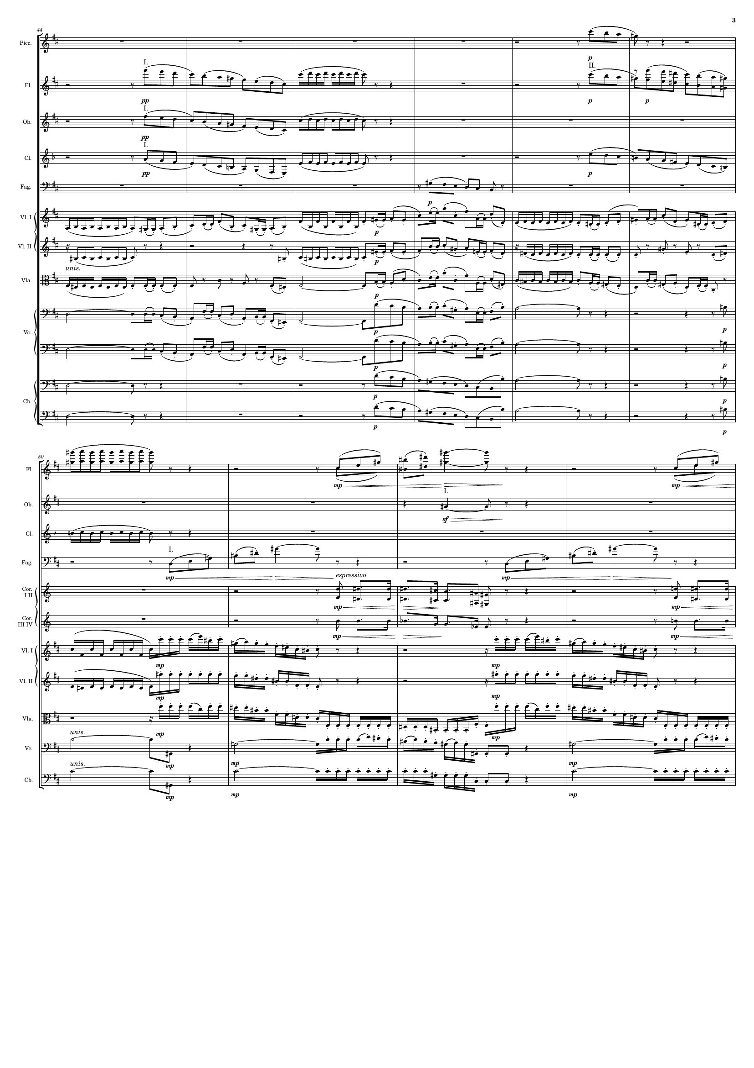
mel
mel
mel
mel
mel
mel
mel
mel+rhythm
rhythm+harm
harm
rhythm+harm
rhythm
harm
mel+rhythm
rhythm
rhythm+harm
c
rhythm+harm
harm
rhythm+harm
harm
harm
harm
harm
harm
harm
harm
mel
harm
mel
mel
harm
harm
mel+rhythm
harm
rhythm+harm
rhythm+harm
harm
mel
harm
rhythm

Slide 4
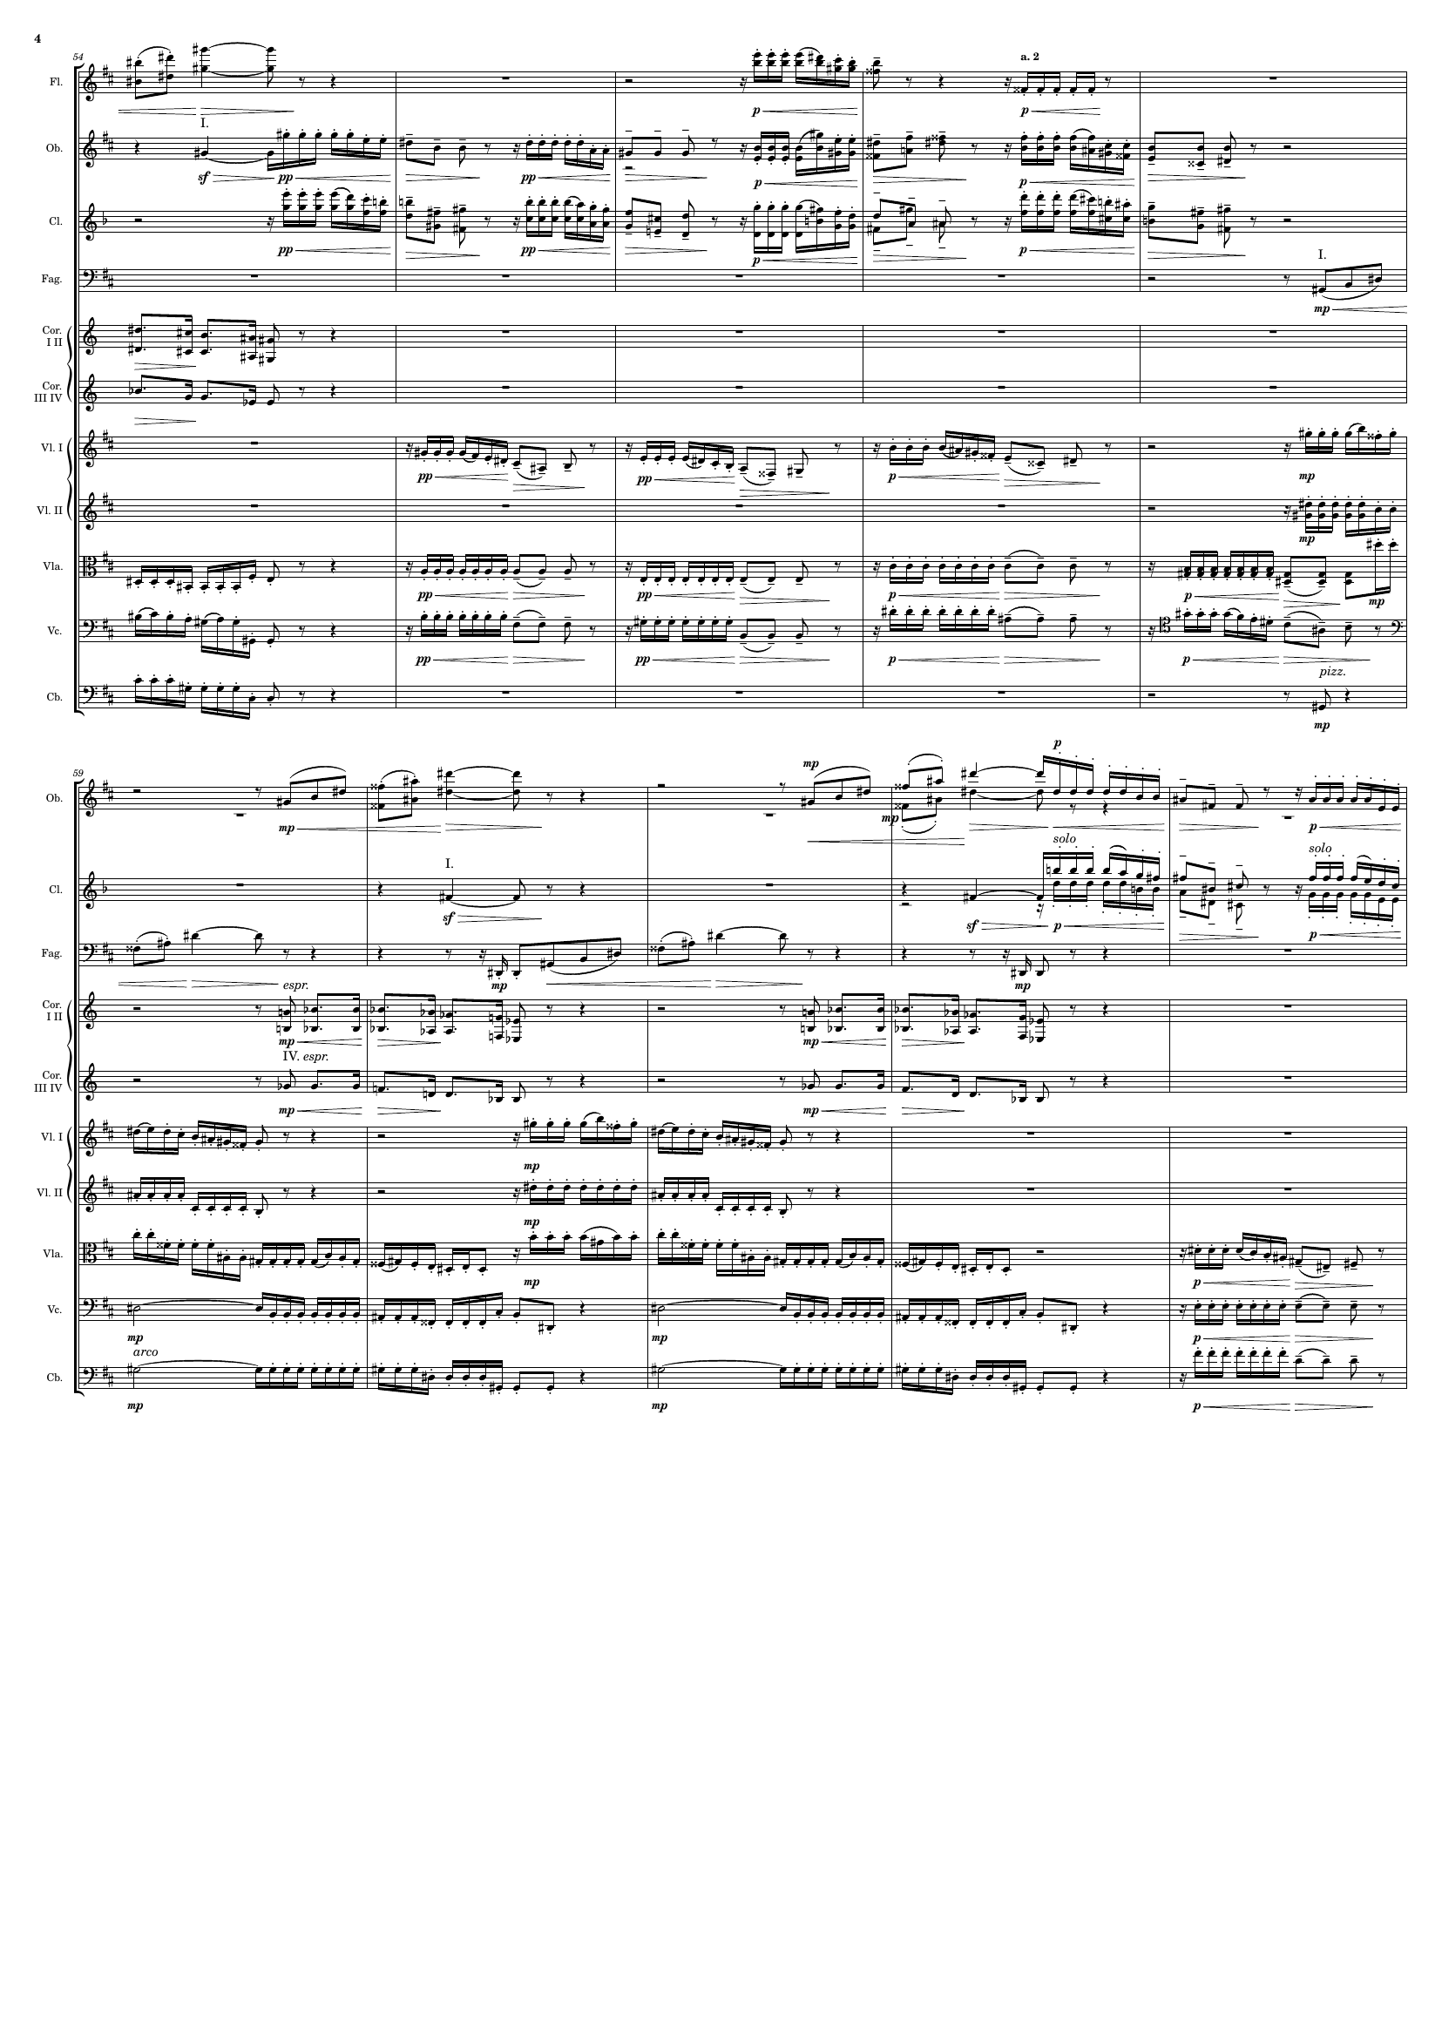
mel
mel+rhythm
rhythm
harm
rhythm
rhythm+harm
mel+rhythm
harm
harm
harm
mel+rhythm
rhythm
rhythm+harm
rhythm
mel
rhythm
rhythm
harm
mel
rhythm+harm
harm
mel+rhythm
harm
mel
harm
rhythm+harm
rhythm+harm
mel+rhythm
rhythm
rhythm+harm
rhythm
rhythm
rhythm

Slide 5
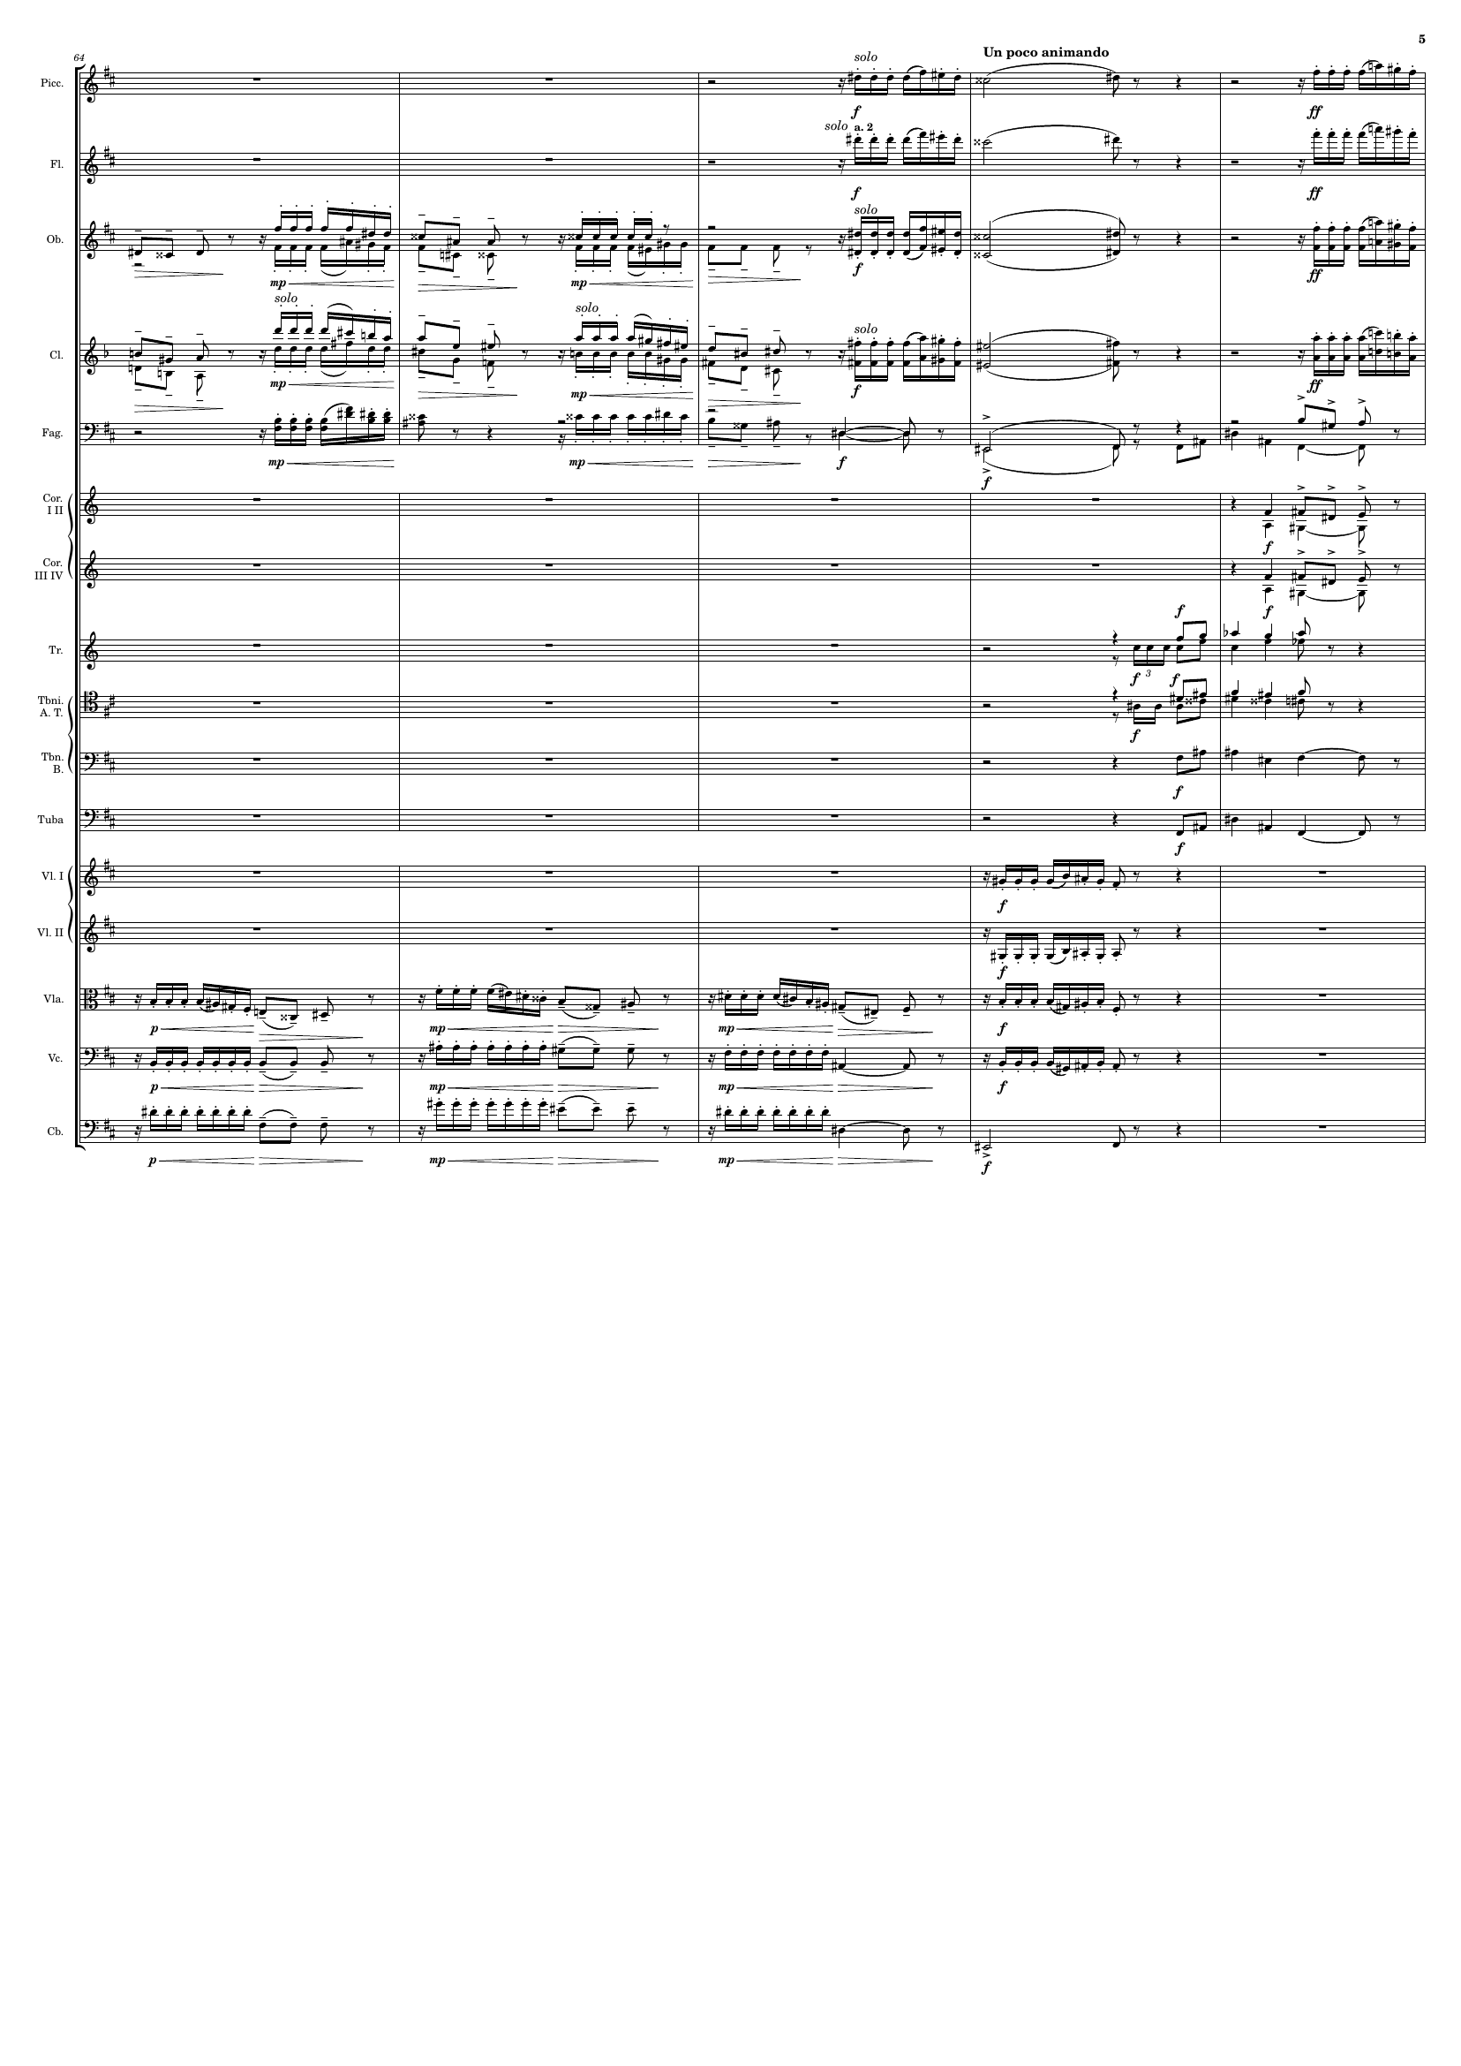
mel+rhythm
mel+rhythm
rhythm+harm
mel+rhythm
mel+rhythm
rhythm+harm
harm
harm
harm
mel+rhythm
mel+rhythm
harm
harm
mel+rhythm
mel+rhythm
mel+rhythm
rhythm+harm
rhythm
harm
rhythm
harm

Slide 6
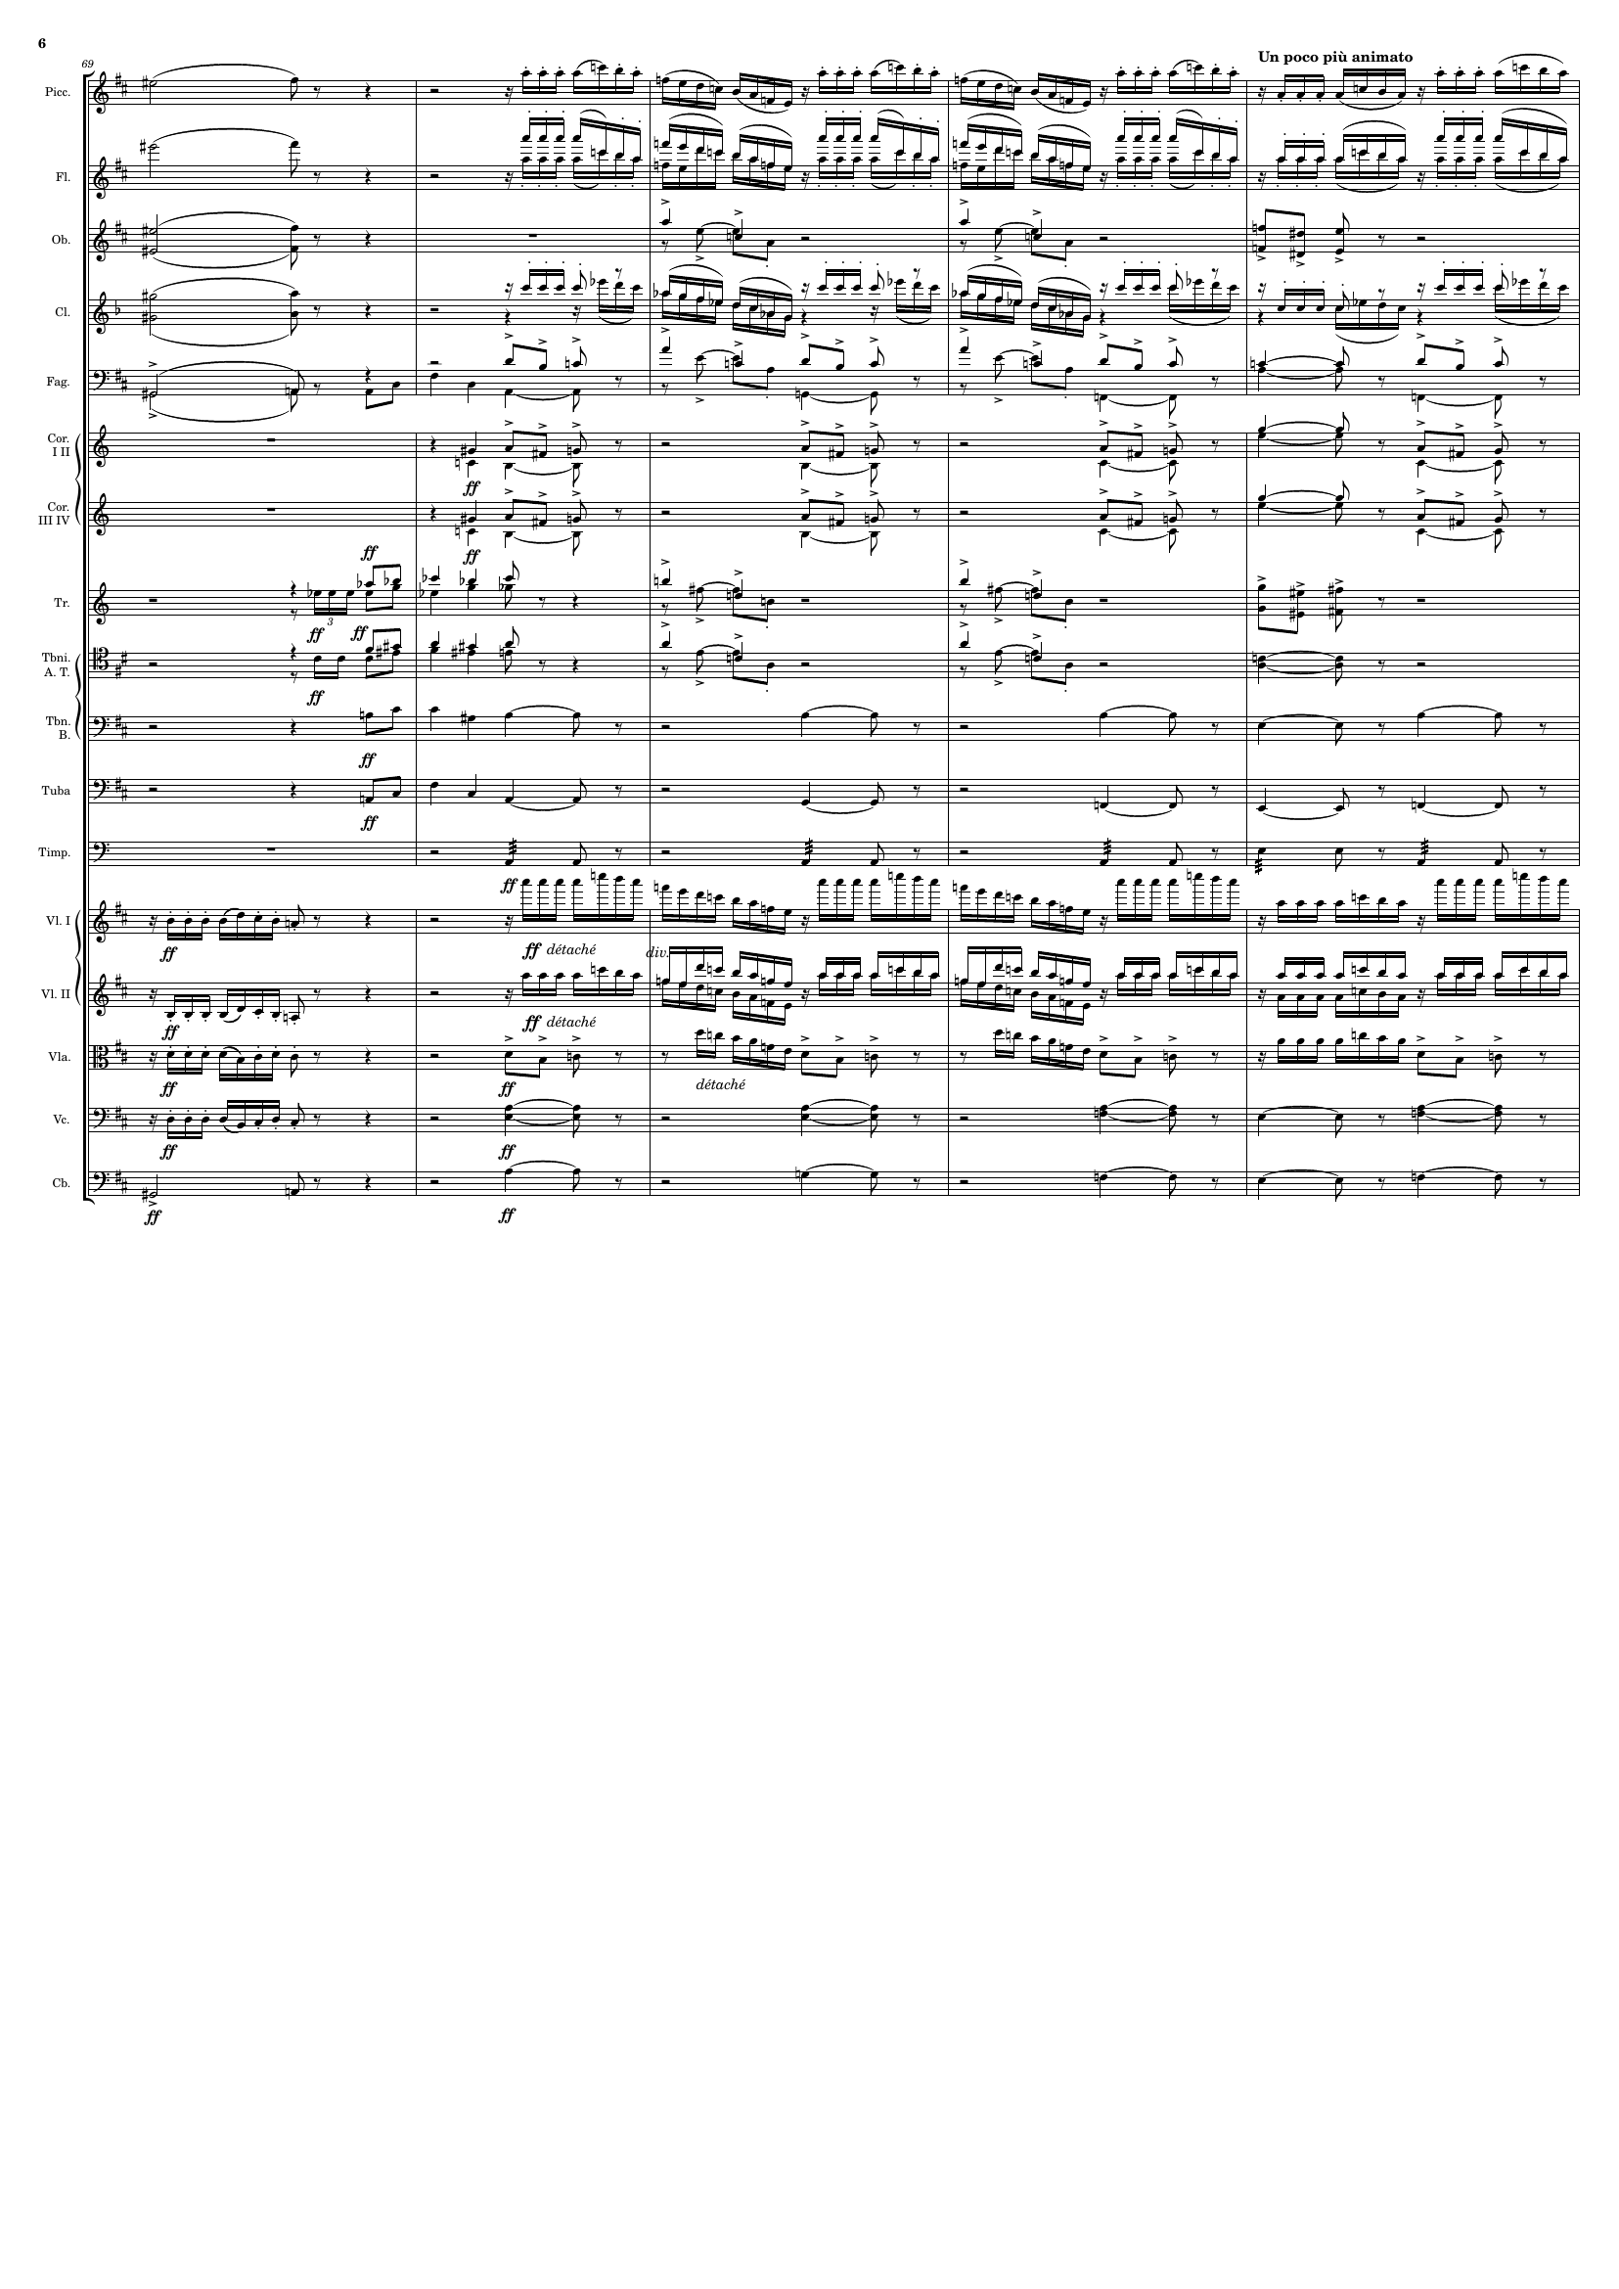
mel+rhythm
mel+rhythm
mel+rhythm
mel
mel+rhythm
harm
mel
harm
mel
mel
harm
mel
mel
harm
mel
mel+rhythm
mel
mel+rhythm
mel
harm
harm
harm
rhythm
mel+rhythm
rhythm+harm
mel+rhythm
rhythm+harm
rhythm+harm
harm
mel+rhythm
rhythm+harm
harm
harm

Slide 7
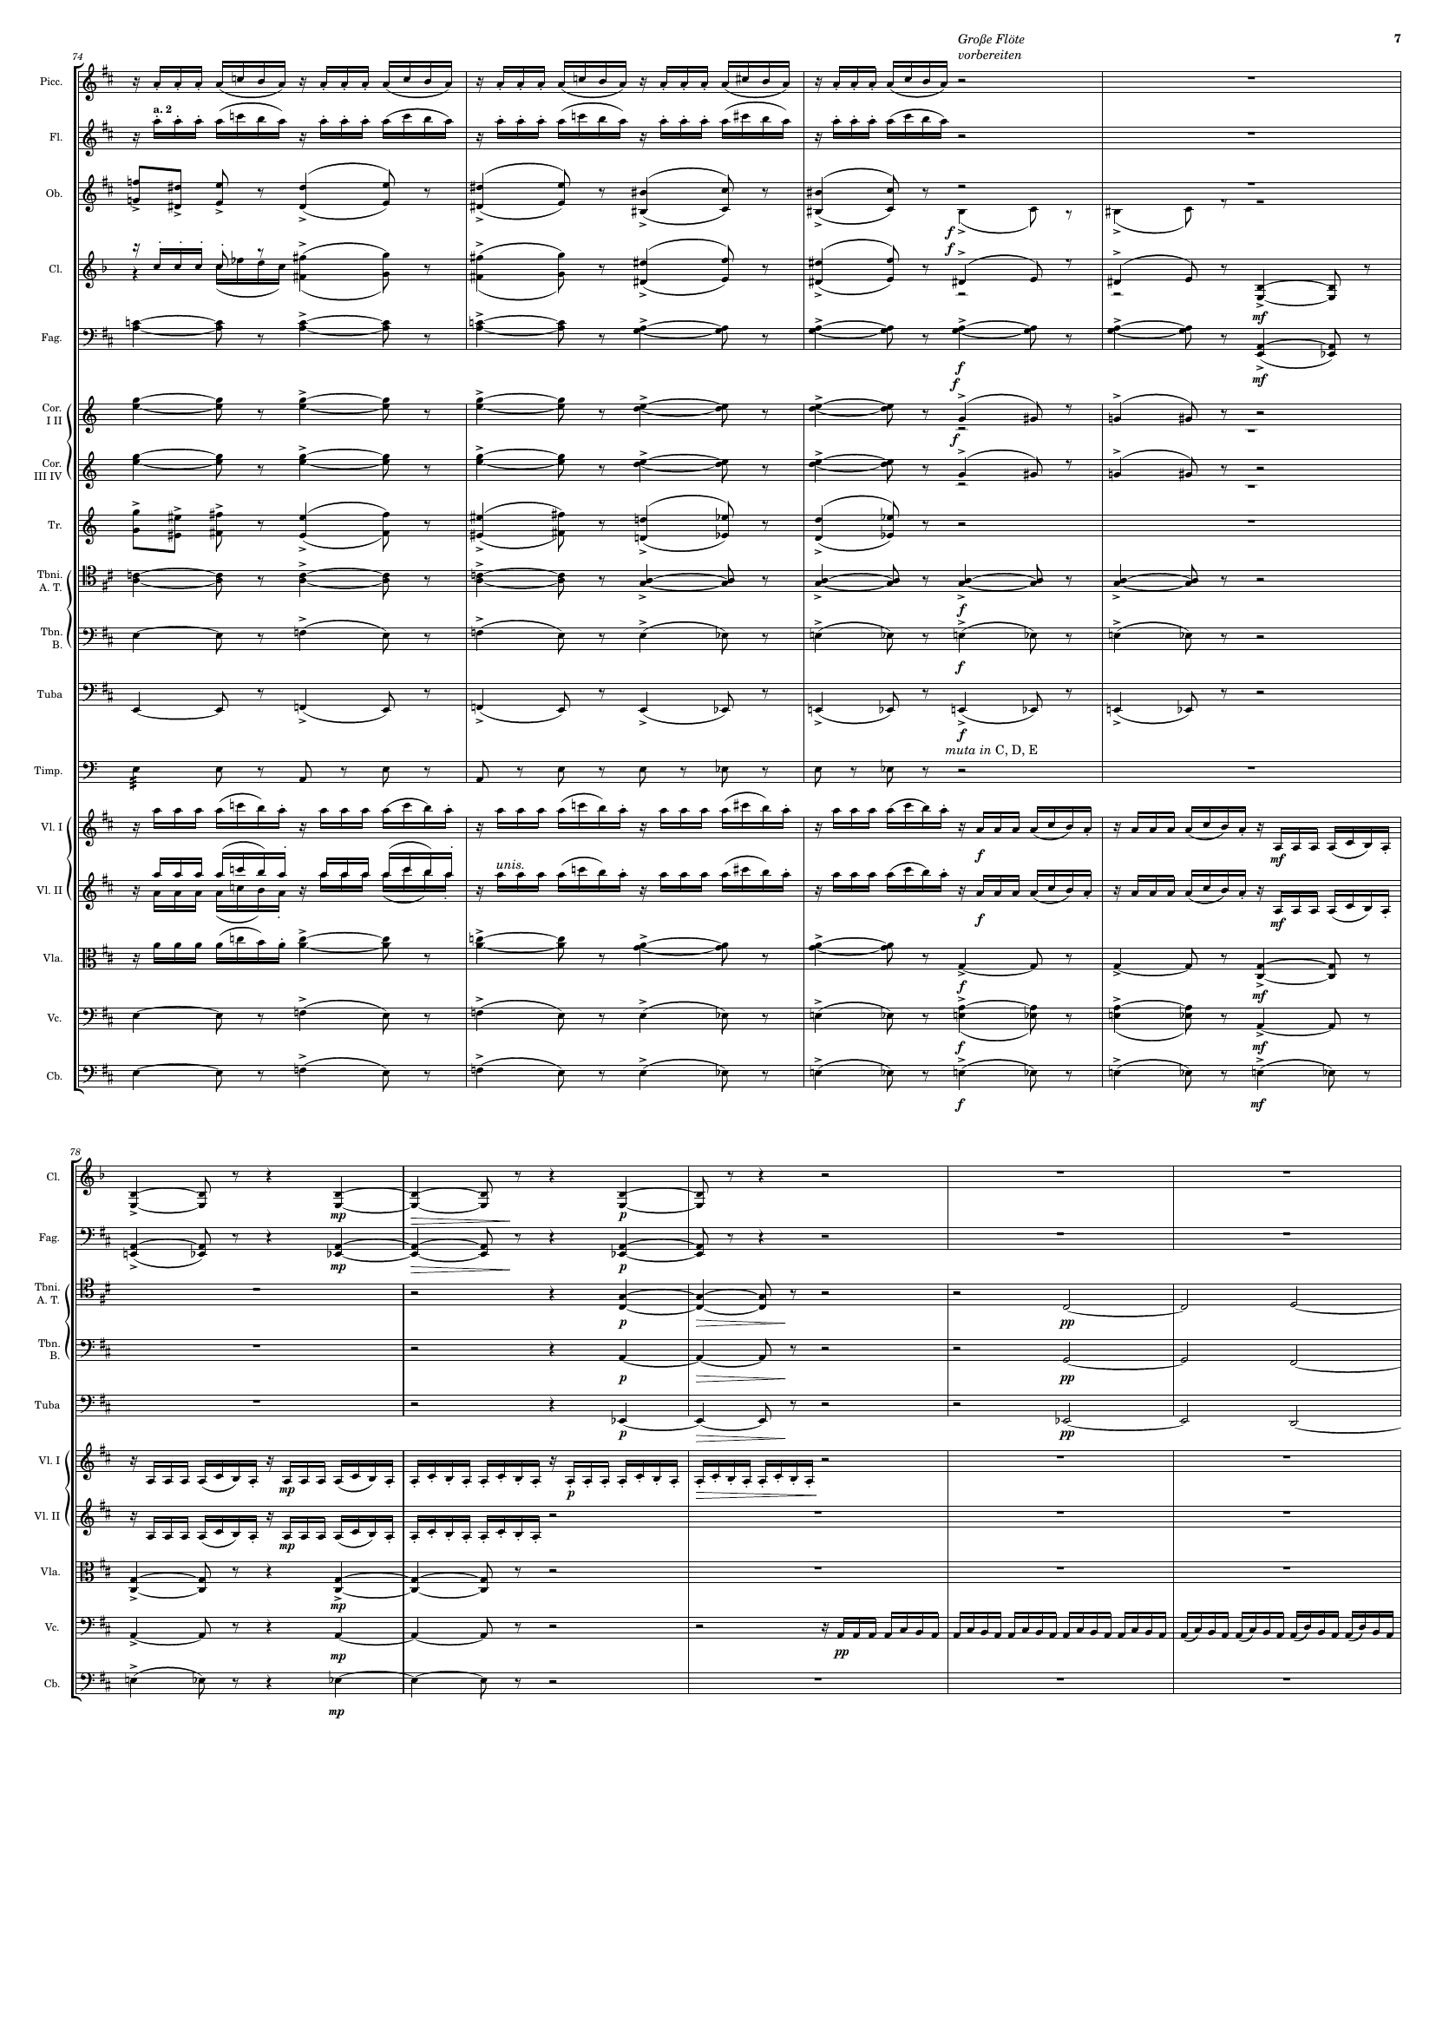
mel+rhythm
mel+rhythm
mel
harm
mel+rhythm
harm
harm
harm
harm
mel
harm
harm
harm
harm
harm
rhythm+harm
rhythm+harm
rhythm+harm
harm
harm
harm
harm
harm
harm
harm
rhythm+harm
harm
rhythm+harm
harm
mel+rhythm
harm
harm

Slide 8
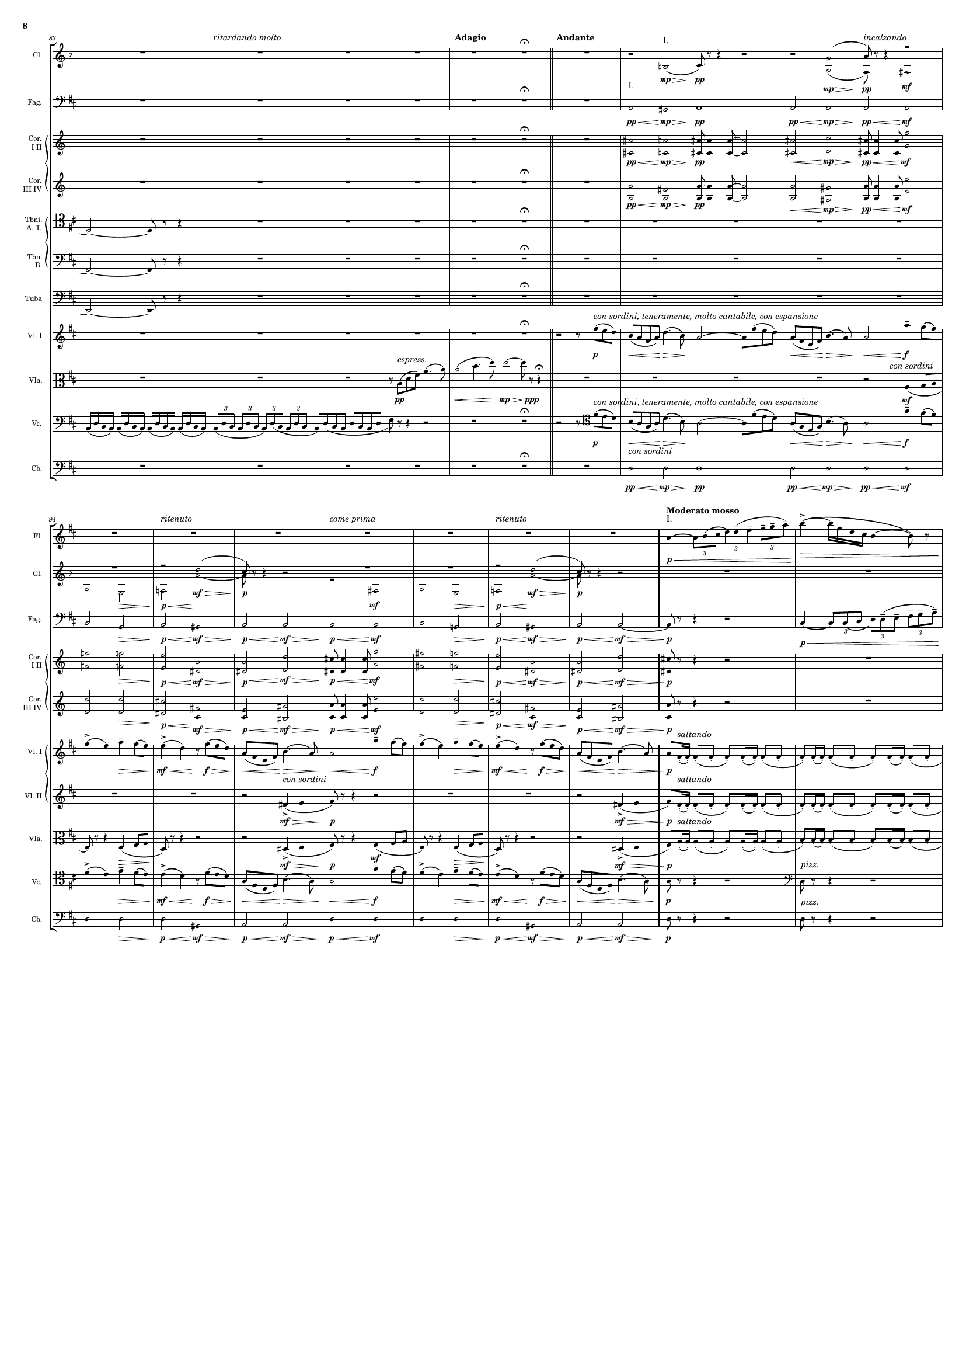
harm
harm
harm
harm
harm
harm
harm
mel
mel
harm
mel+rhythm
mel
harm
mel
harm
harm
mel
harm
harm
mel
rhythm+harm
harm
rhythm+harm
harm
rhythm+harm
mel
mel
rhythm
harm
rhythm

Slide 9
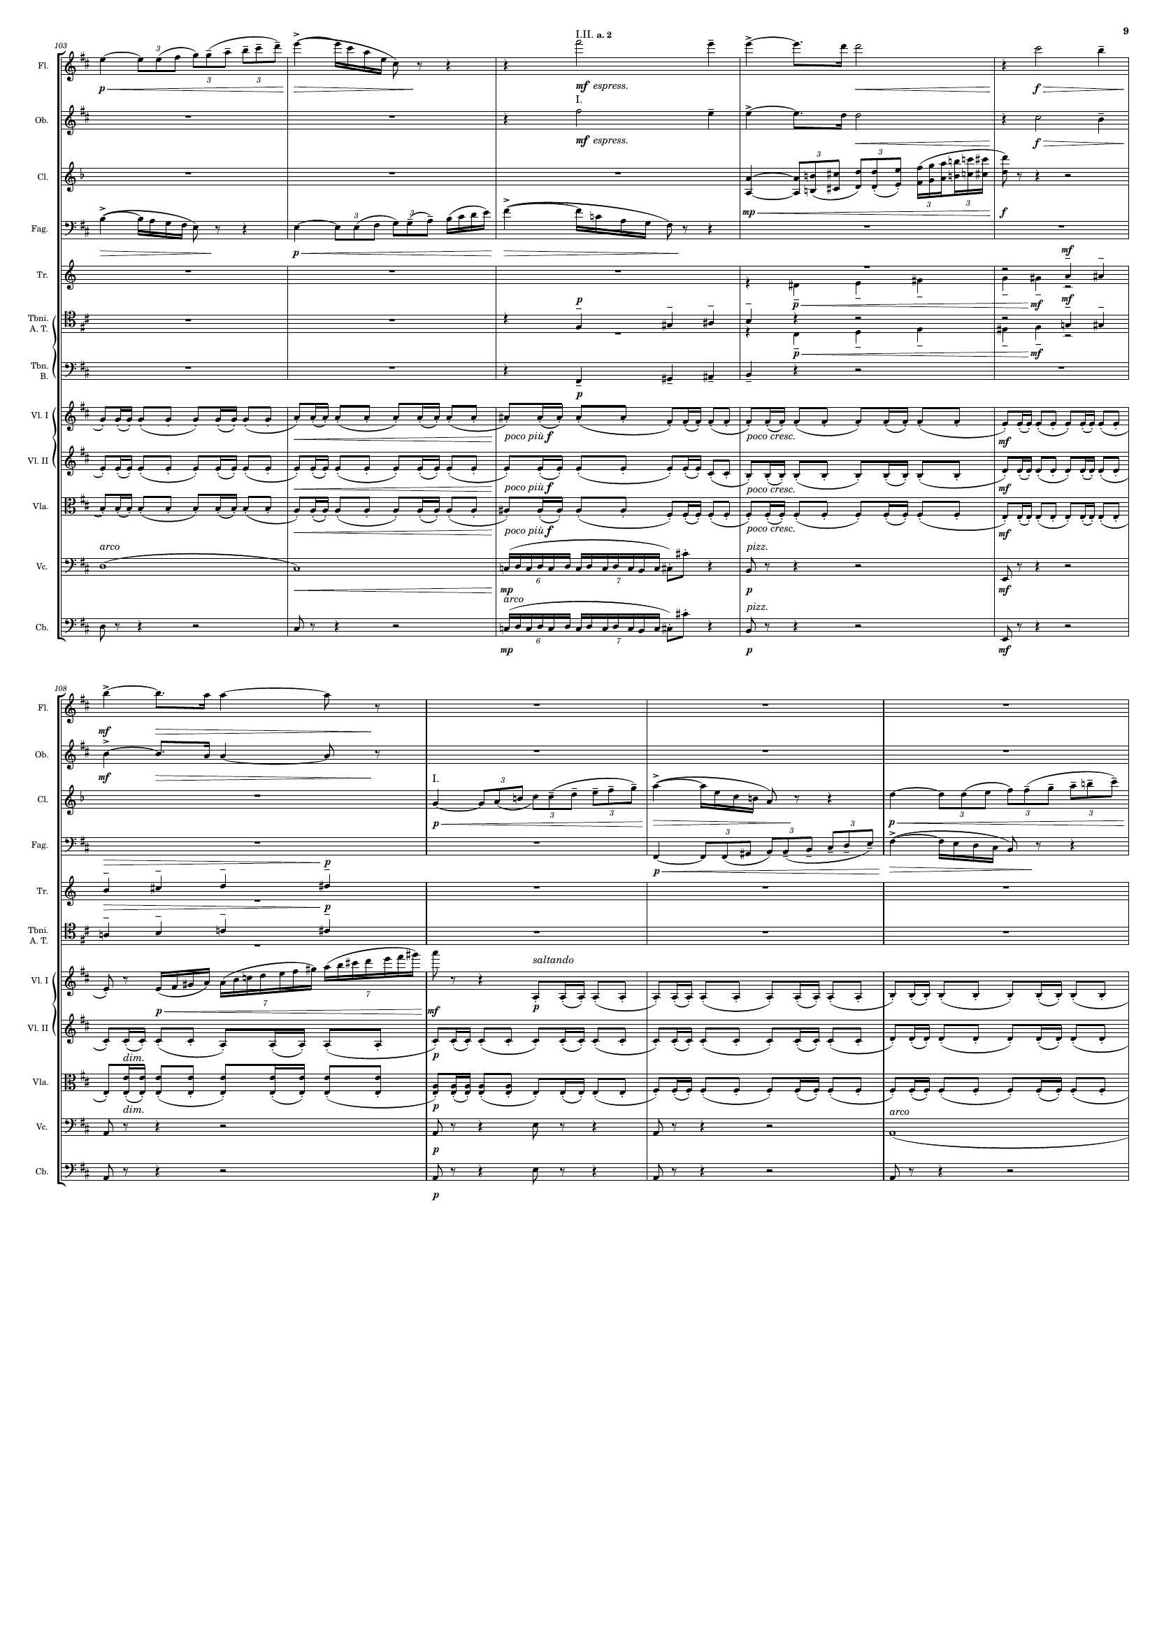
mel
mel
mel
mel
harm
harm
harm
rhythm+harm
rhythm+harm
rhythm+harm
rhythm
harm
rhythm
harm
mel
mel
mel
mel
harm
harm
rhythm+harm
mel
rhythm+harm
rhythm+harm
rhythm+harm
harm
harm

Slide 10
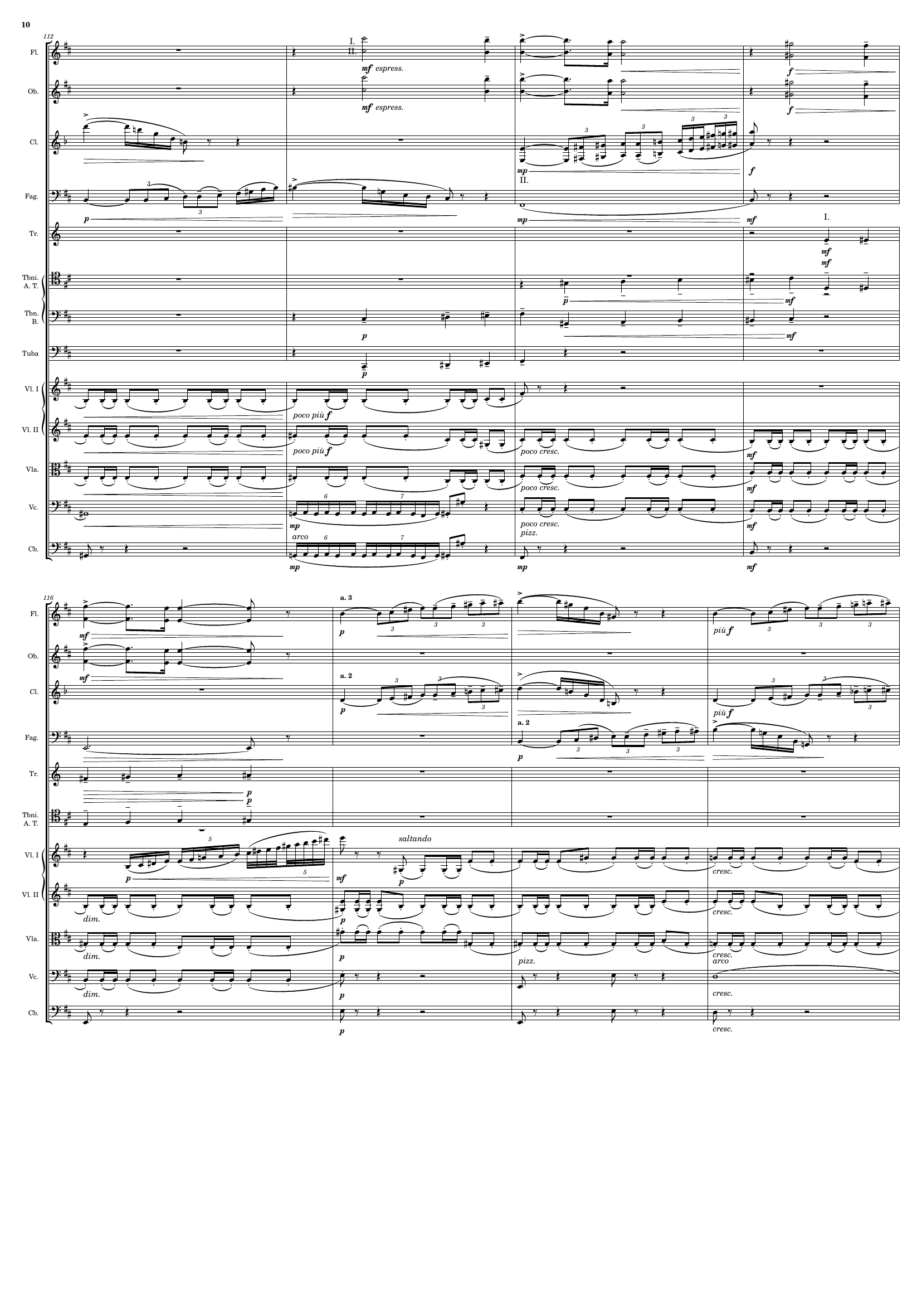
mel
mel
mel
mel
harm
harm
harm
harm
harm
rhythm+harm
rhythm+harm
rhythm+harm
harm
rhythm+harm
harm
mel
mel
mel
harm
mel
harm
harm
mel
rhythm+harm
rhythm+harm
rhythm+harm
rhythm+harm
harm
harm

Slide 11
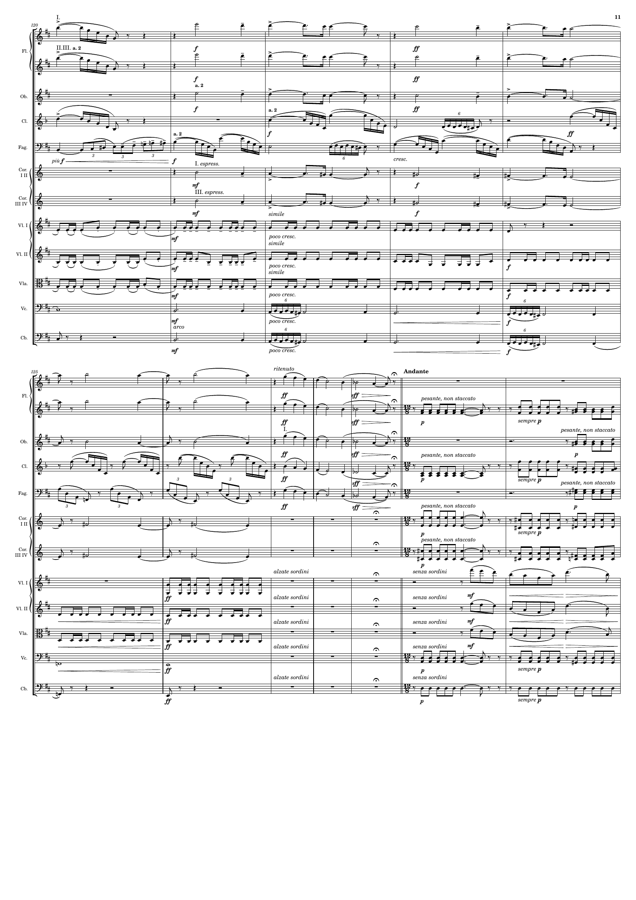
mel
mel
mel
mel
harm
mel
harm
mel
mel
rhythm
rhythm+harm
rhythm
harm
harm
mel
mel
rhythm
mel
rhythm
harm
mel
rhythm
harm
mel
rhythm
mel
rhythm
mel
rhythm
rhythm+harm
mel+rhythm
rhythm+harm
mel+rhythm
rhythm+harm
mel+rhythm
harm
rhythm
harm
rhythm

Slide 12
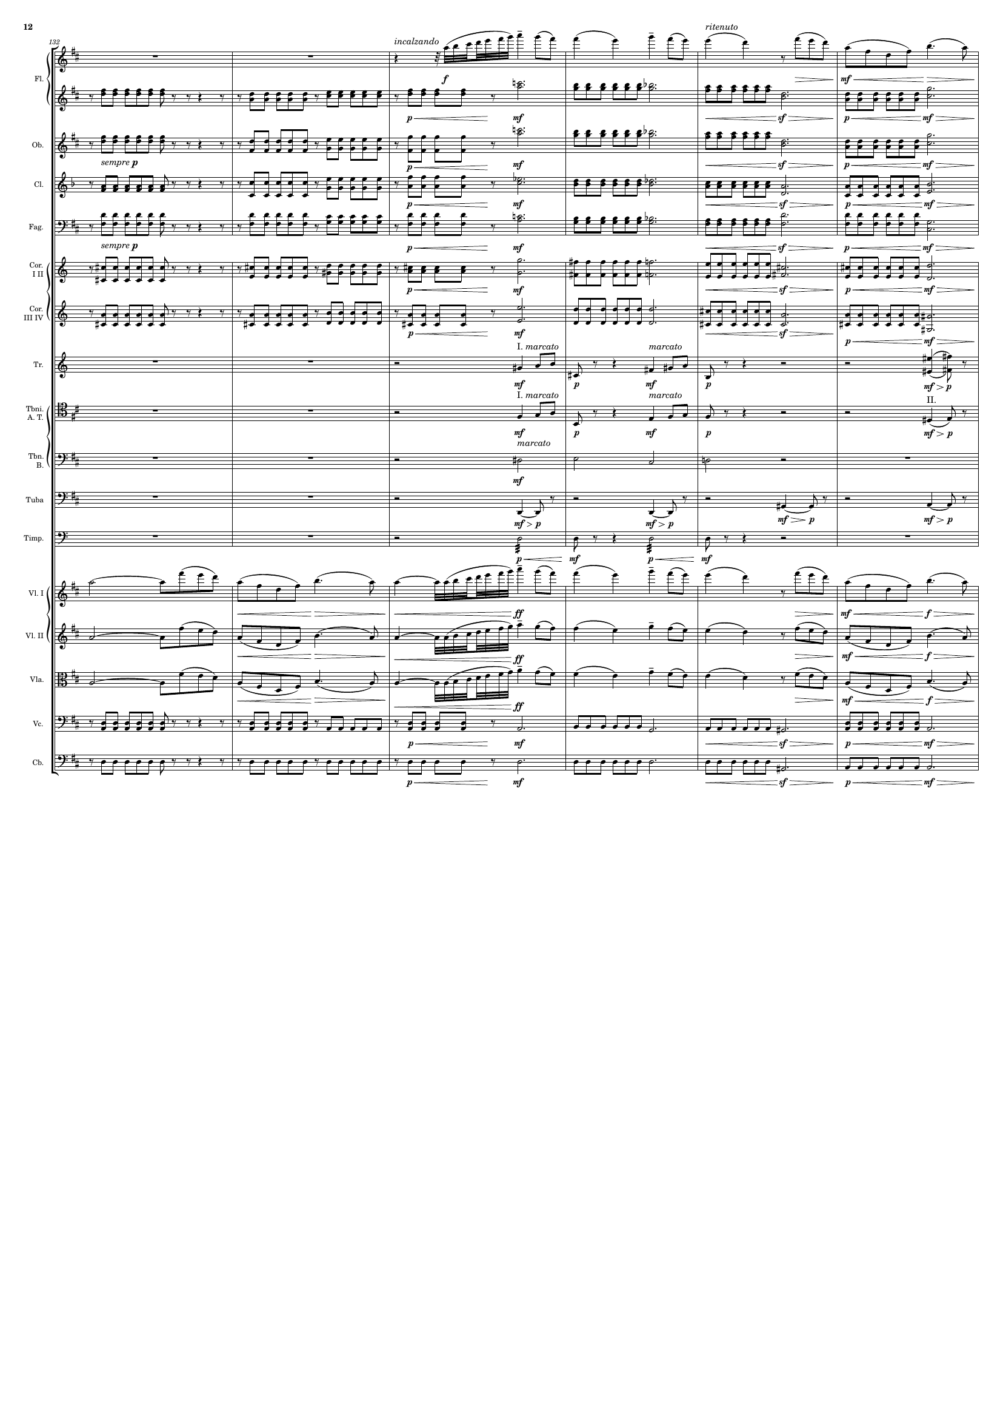
mel+rhythm
rhythm
rhythm
rhythm
rhythm
rhythm
rhythm
harm
harm
harm
harm
rhythm
mel+rhythm
mel+rhythm
mel+rhythm
rhythm
rhythm

Slide 13
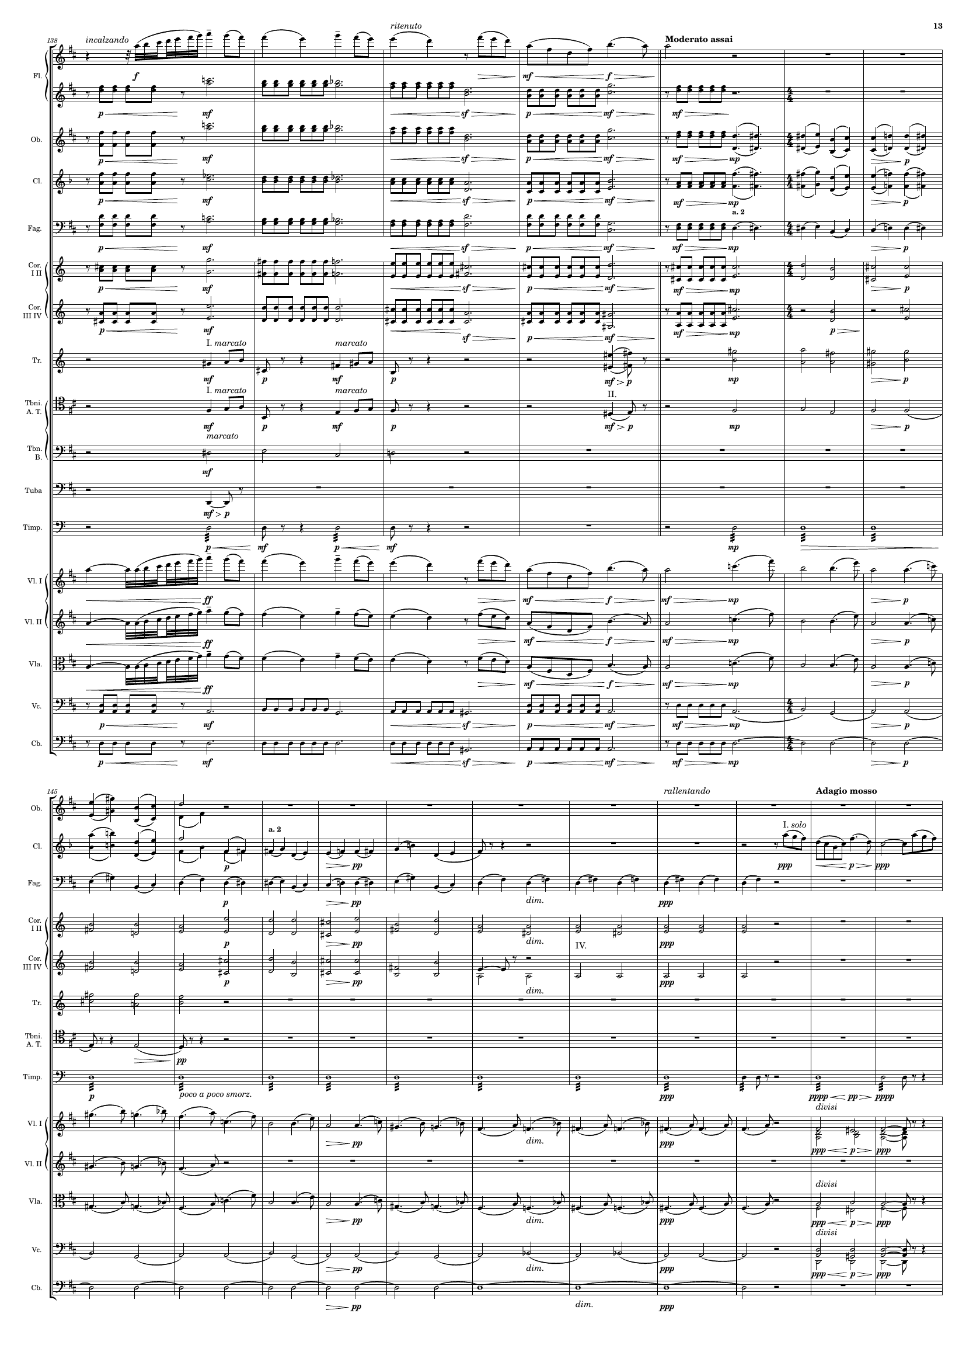
mel+rhythm
rhythm
rhythm
harm
rhythm
harm
rhythm
harm
rhythm
harm
rhythm
harm
harm
harm
harm
harm
mel+rhythm
mel
mel+rhythm
mel
mel+rhythm
mel
rhythm
harm
rhythm
harm
harm
mel+rhythm
harm
harm
harm
harm
harm
rhythm
mel
harm
mel
mel
harm
harm
rhythm

Slide 14
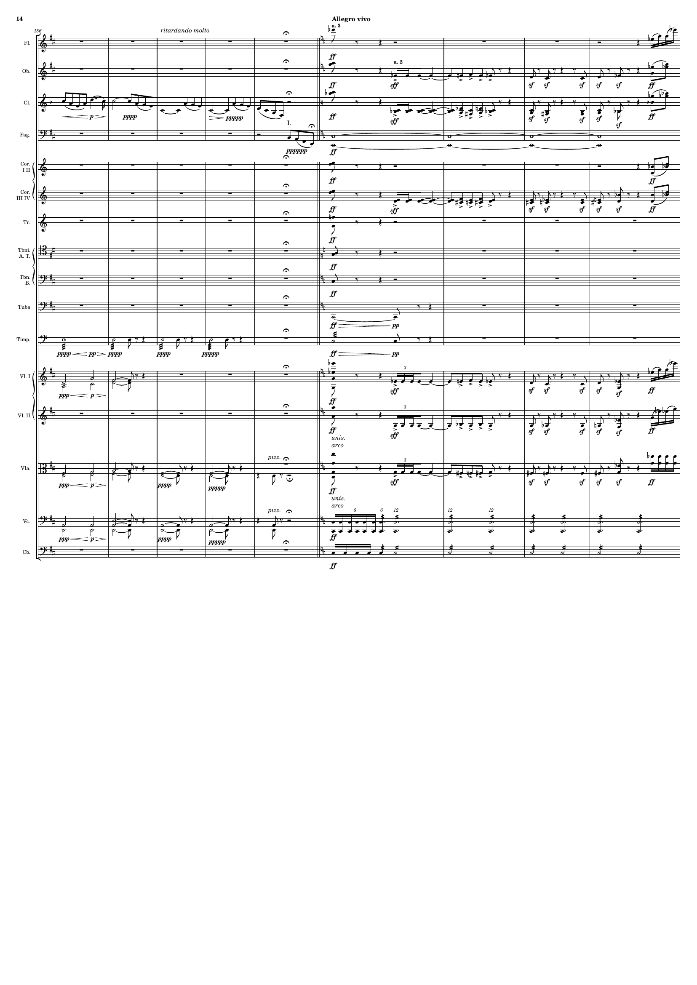
mel+rhythm
harm
mel+rhythm
mel+rhythm
harm
rhythm+harm
mel
mel+rhythm
harm
rhythm+harm
mel+rhythm
harm
harm
harm
harm
rhythm
harm
harm
mel
mel+rhythm
harm
rhythm+harm
harm
harm
rhythm+harm
harm
rhythm
rhythm

Slide 15
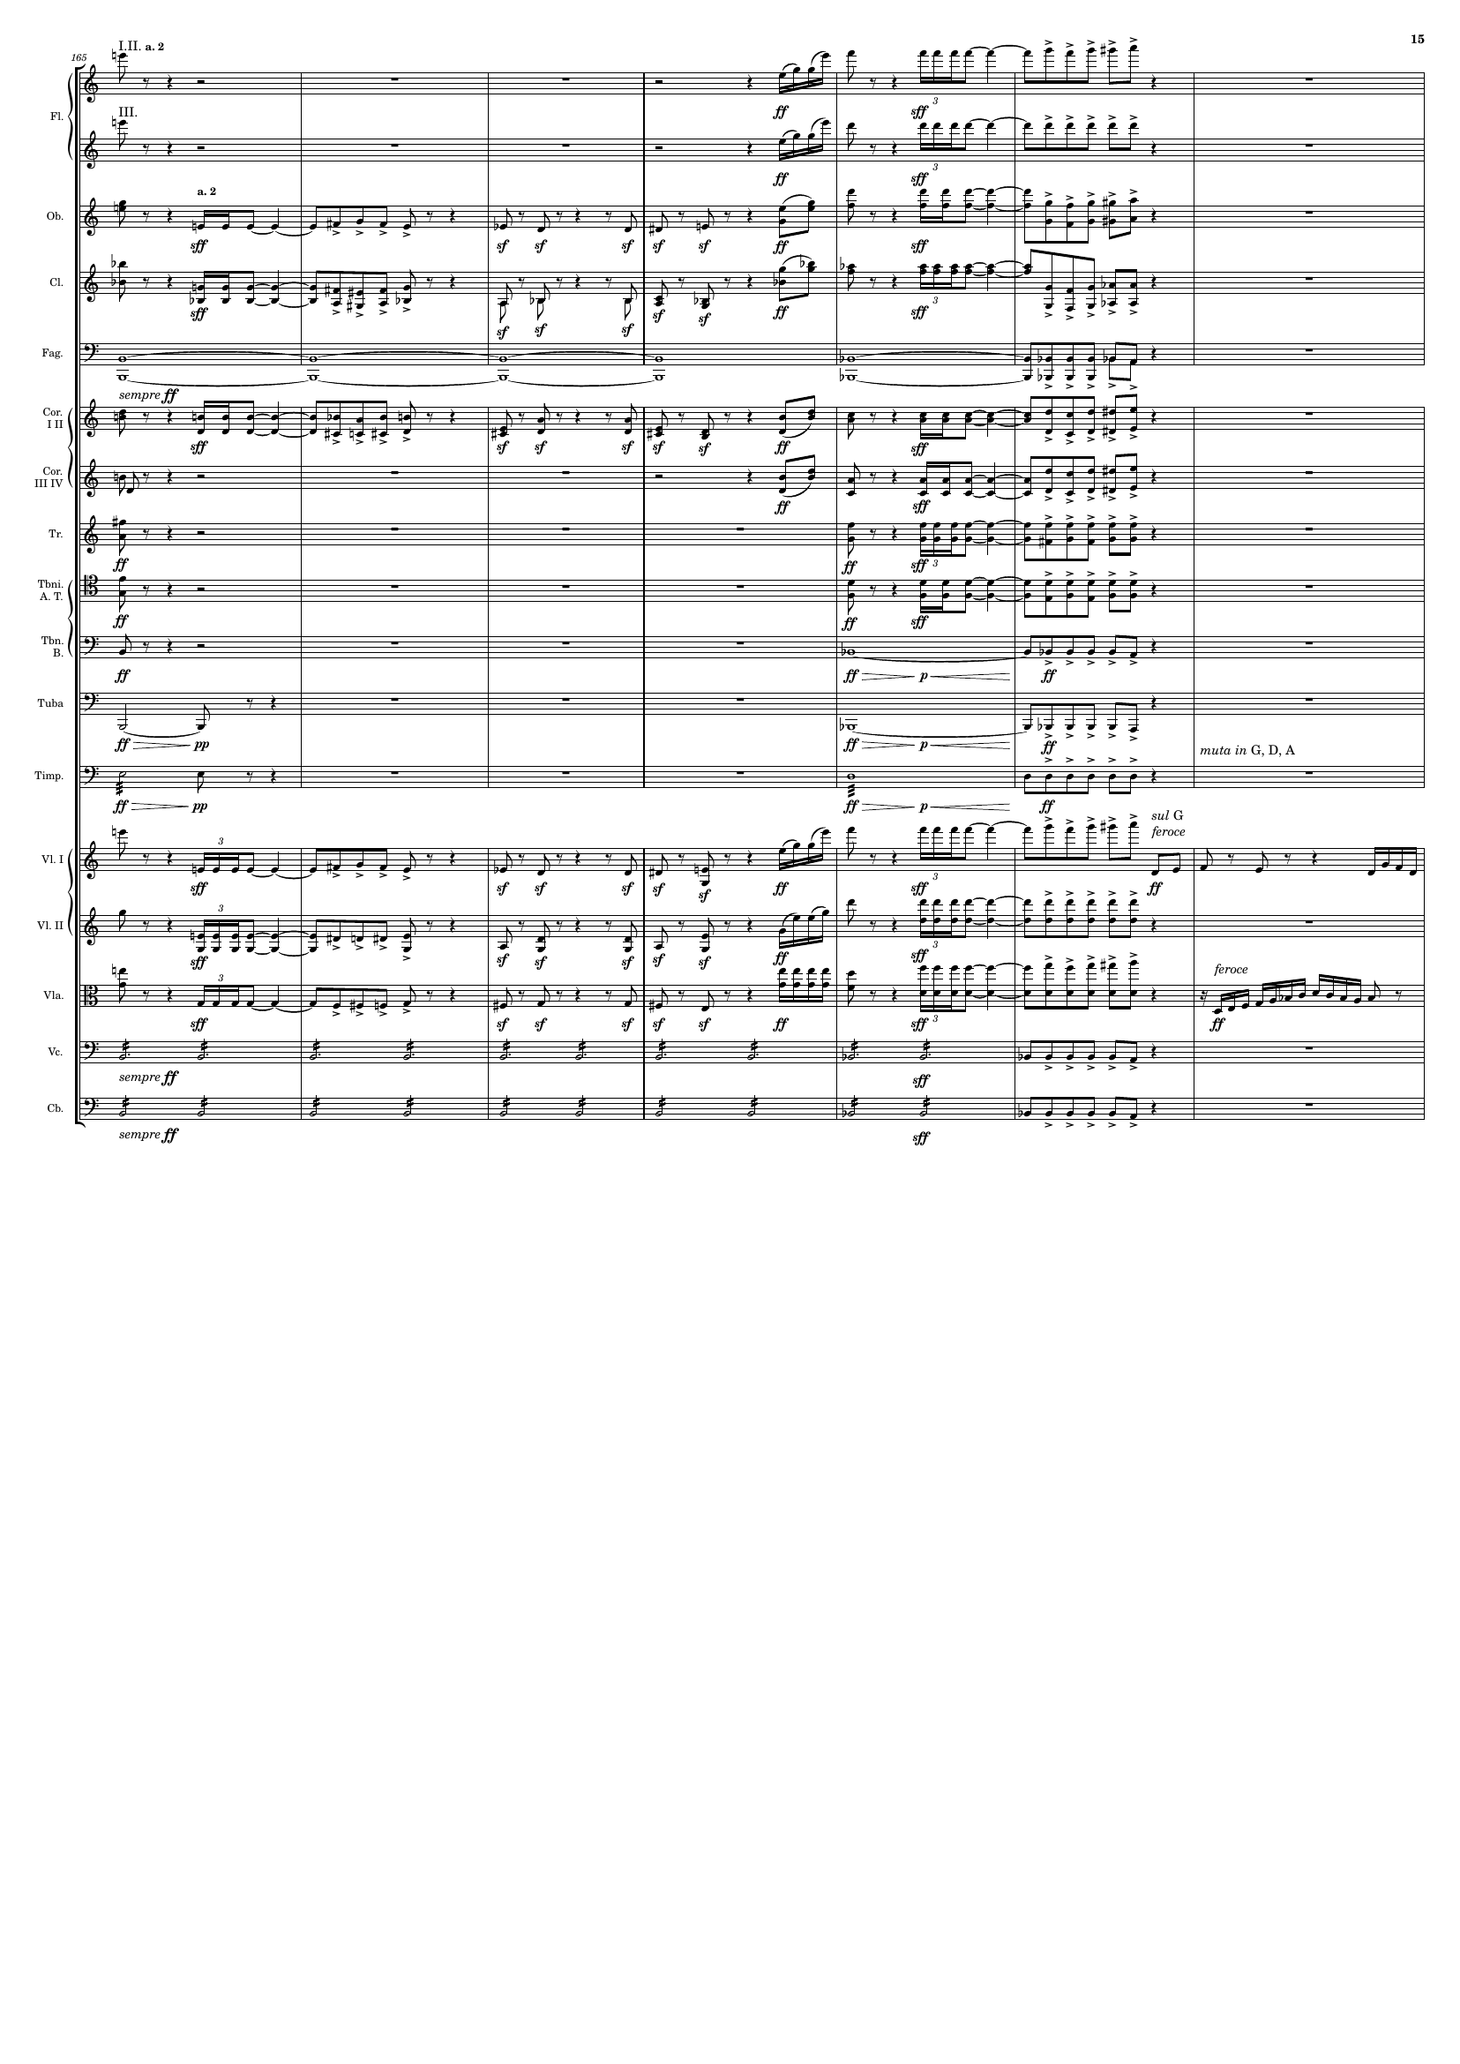
mel+rhythm
mel+rhythm
mel+rhythm
rhythm+harm
mel+rhythm
rhythm+harm
rhythm
harm
mel+rhythm
rhythm+harm
mel+rhythm
mel+rhythm
rhythm+harm
mel+rhythm
mel
rhythm+harm
mel
rhythm+harm
harm
rhythm+harm
harm
rhythm+harm
rhythm
mel+rhythm
rhythm+harm
rhythm+harm
mel+rhythm
rhythm
rhythm

Slide 16
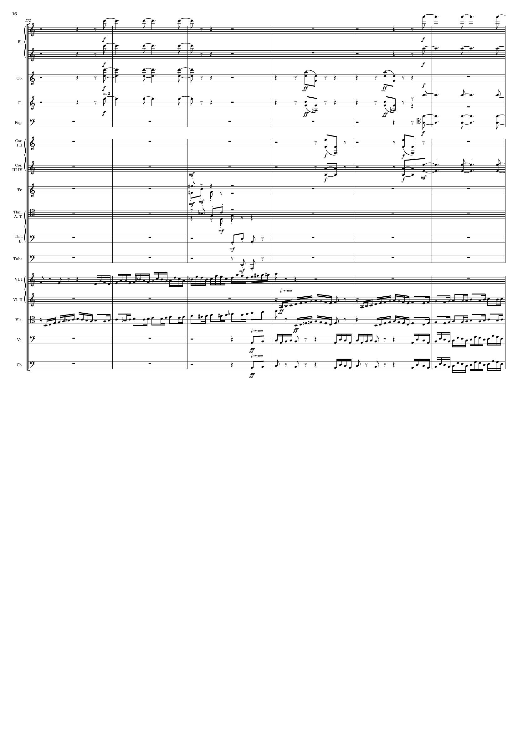
rhythm
rhythm
rhythm
rhythm+harm
rhythm
rhythm+harm
rhythm
rhythm
rhythm+harm
rhythm+harm
rhythm
rhythm+harm
rhythm+harm
rhythm+harm
rhythm+harm
mel+rhythm
mel+rhythm
mel+rhythm
harm
harm

Slide 17
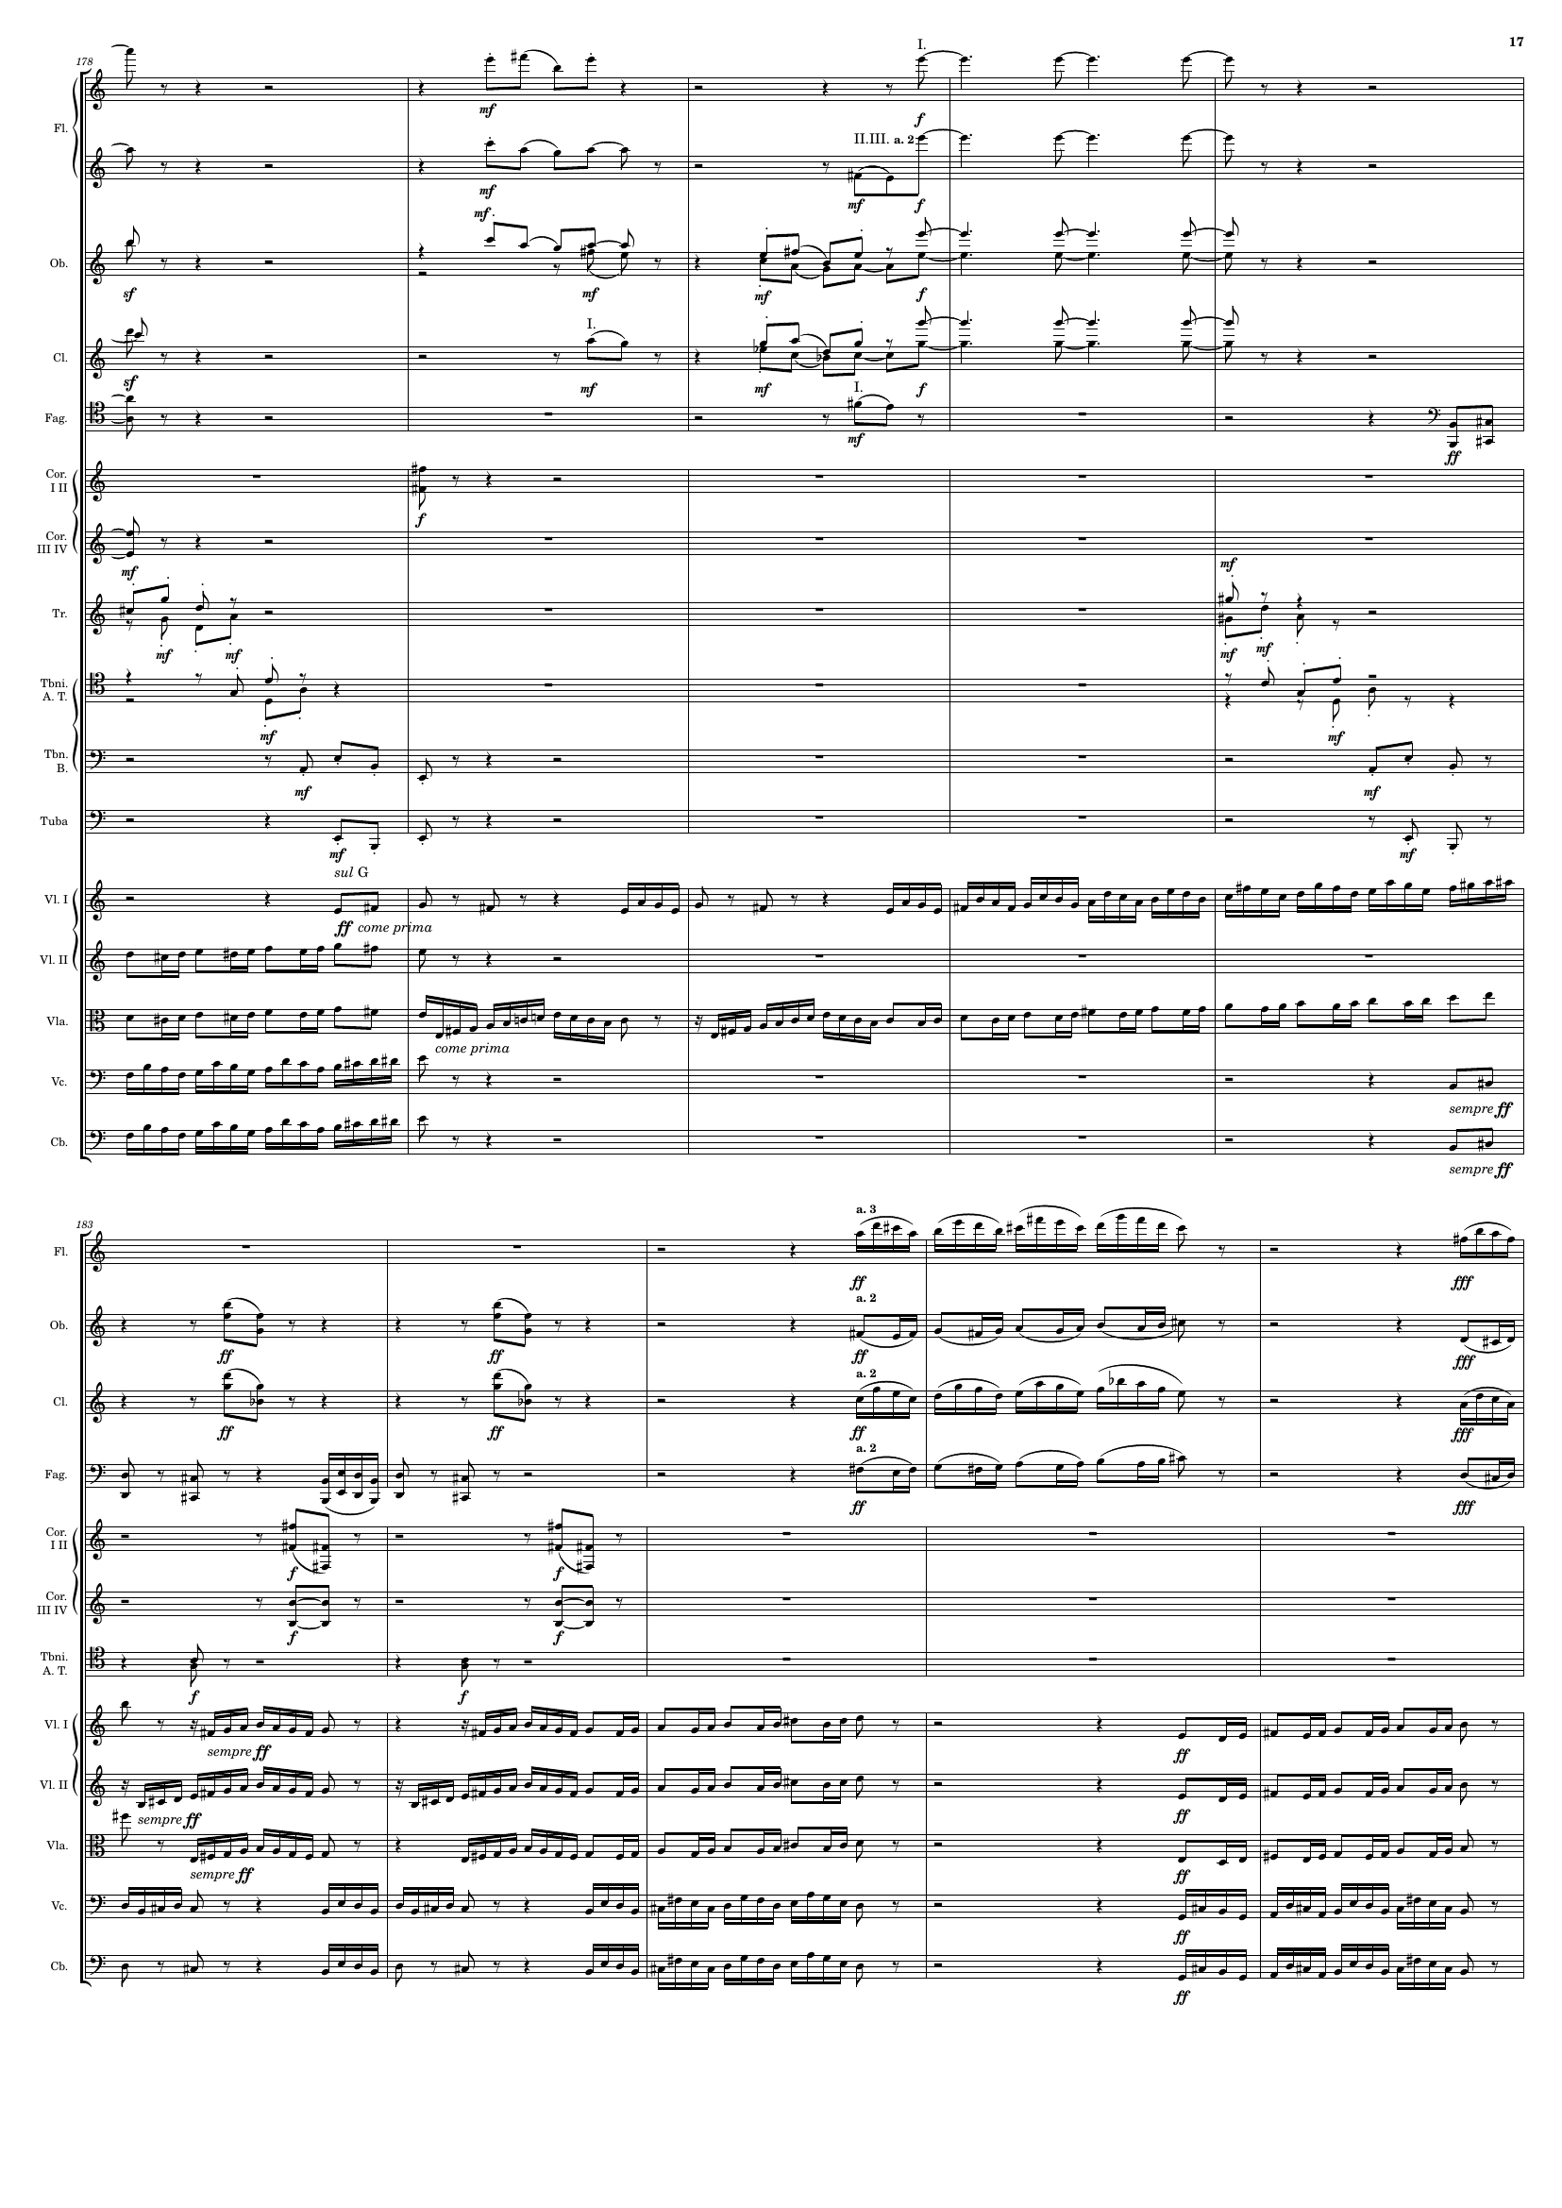
rhythm
rhythm
rhythm
harm
rhythm
rhythm
harm
rhythm
rhythm
harm
rhythm
rhythm
harm
mel+rhythm
harm
rhythm
mel+rhythm
mel+rhythm
mel+rhythm
harm
mel+rhythm
harm
mel+rhythm
harm
rhythm+harm
mel+rhythm
rhythm+harm
harm
mel+rhythm
rhythm+harm
rhythm+harm
rhythm+harm
mel+rhythm
mel+rhythm
mel+rhythm
mel+rhythm
harm
mel+rhythm
harm

Slide 18
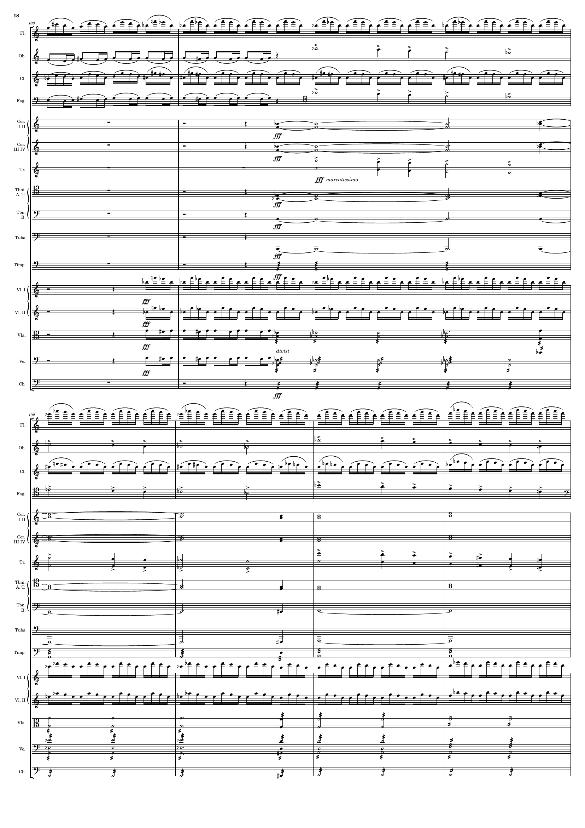
harm
rhythm
mel+rhythm
mel
harm
rhythm
mel+rhythm
mel
harm
harm
mel
harm
harm
harm
rhythm
rhythm
rhythm
rhythm
rhythm
rhythm
rhythm
rhythm
rhythm
mel
rhythm
mel
harm
harm
mel
harm
harm
harm
rhythm
rhythm
rhythm
rhythm
rhythm
rhythm

Slide 19
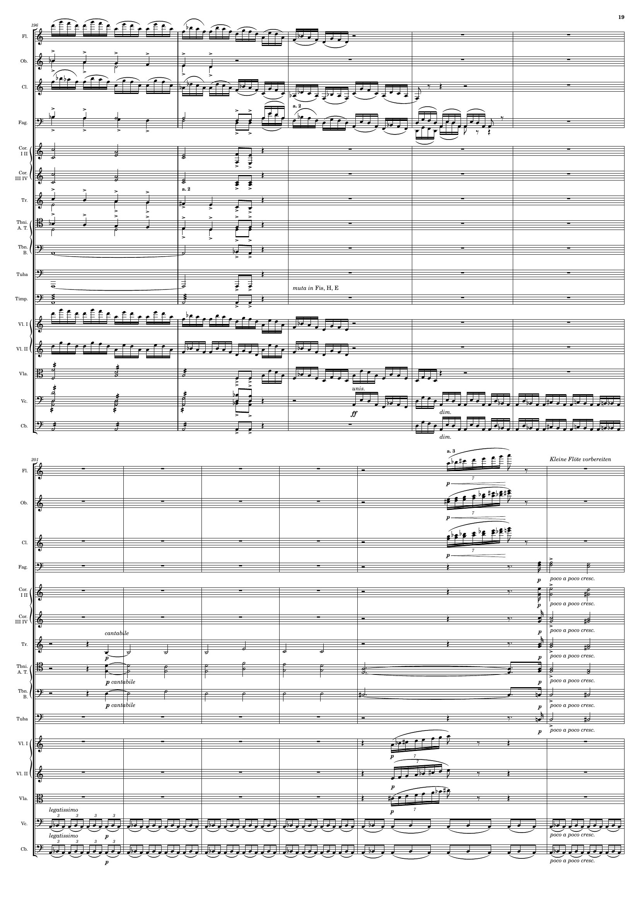
rhythm
mel
rhythm
mel
rhythm
harm
harm
mel
mel
harm
harm
rhythm
rhythm
rhythm
rhythm
rhythm
rhythm
harm
harm
harm
mel+rhythm
mel+rhythm
mel+rhythm
harm
mel+rhythm
mel
mel+rhythm
harm
rhythm+harm
rhythm+harm
harm
harm
harm
rhythm
rhythm

Slide 20
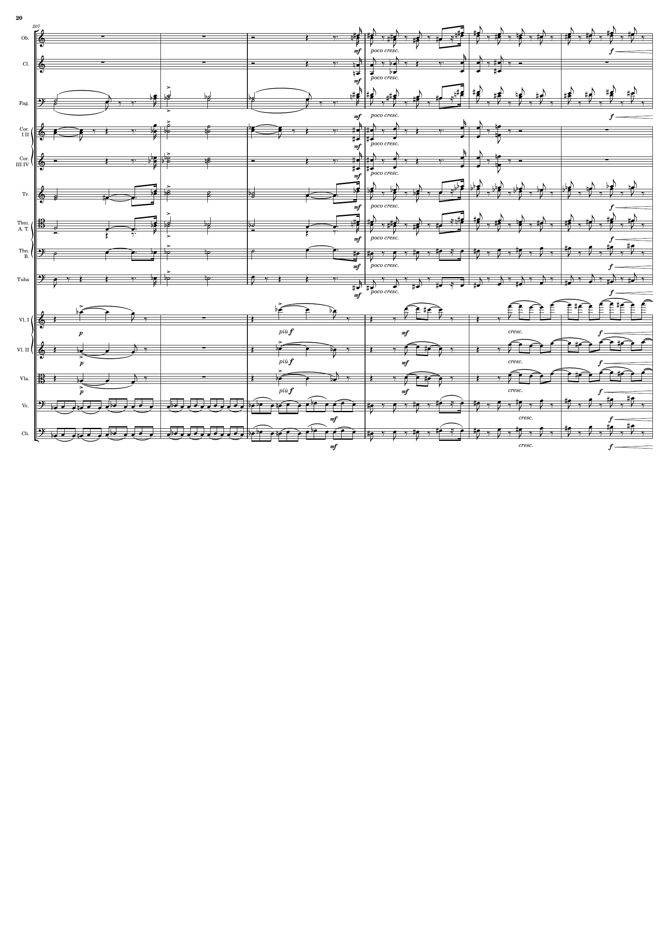
rhythm+harm
rhythm+harm
mel+rhythm
rhythm+harm
mel+rhythm
rhythm+harm
rhythm+harm
rhythm+harm
mel+rhythm
rhythm+harm
mel+rhythm
rhythm+harm
rhythm+harm
rhythm
rhythm+harm
rhythm
mel+rhythm
mel+rhythm
mel+rhythm
rhythm
rhythm

Slide 21
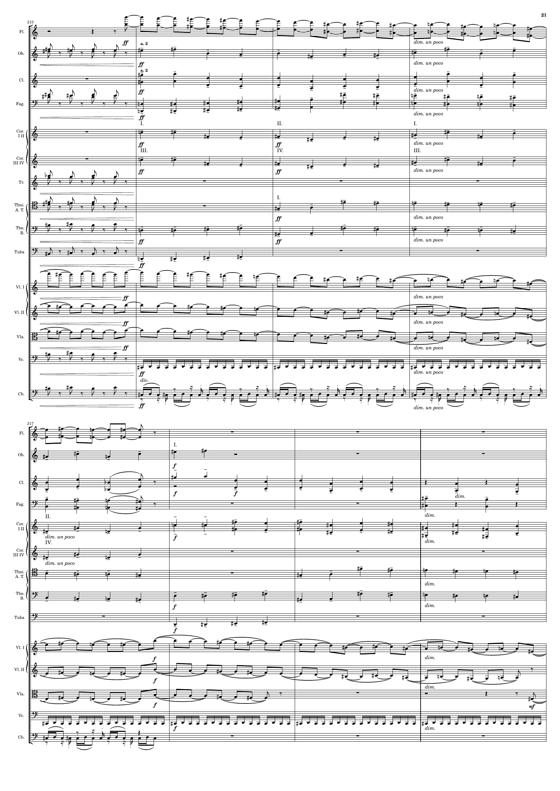
mel+rhythm
rhythm+harm
harm
harm
rhythm+harm
harm
harm
harm
rhythm+harm
rhythm+harm
harm
rhythm
harm
rhythm
harm
mel+rhythm
mel+rhythm
mel+rhythm
rhythm
rhythm
mel+rhythm
harm
harm
harm
harm
harm
harm
harm
harm
mel+rhythm
mel+rhythm
mel+rhythm
rhythm
rhythm

Slide 22
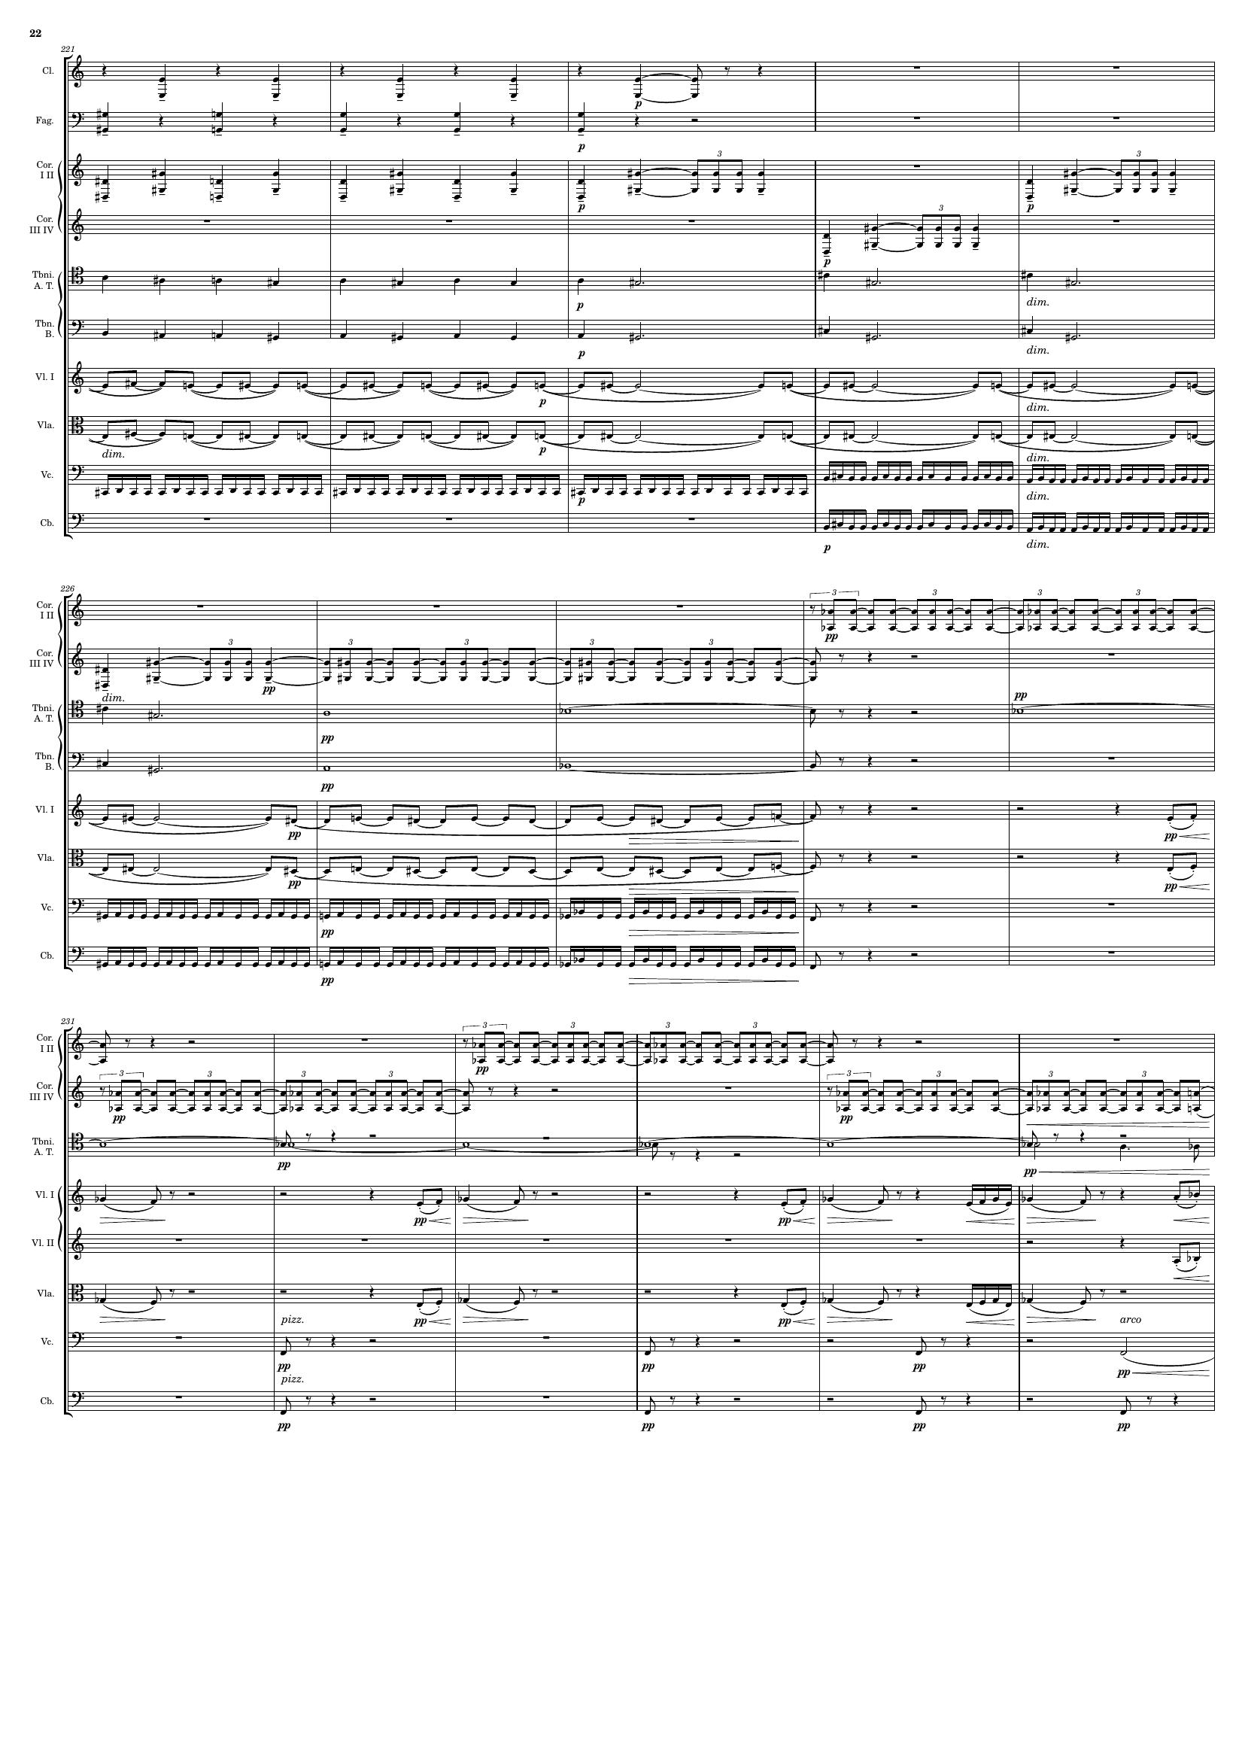
rhythm
harm
rhythm
harm
rhythm
rhythm
harm
harm
mel+rhythm
mel+rhythm
rhythm
rhythm
rhythm
rhythm
harm
rhythm
harm
mel+rhythm
mel+rhythm
rhythm
rhythm
rhythm
rhythm
rhythm
mel+rhythm
mel+rhythm
mel+rhythm
rhythm
rhythm

Slide 23
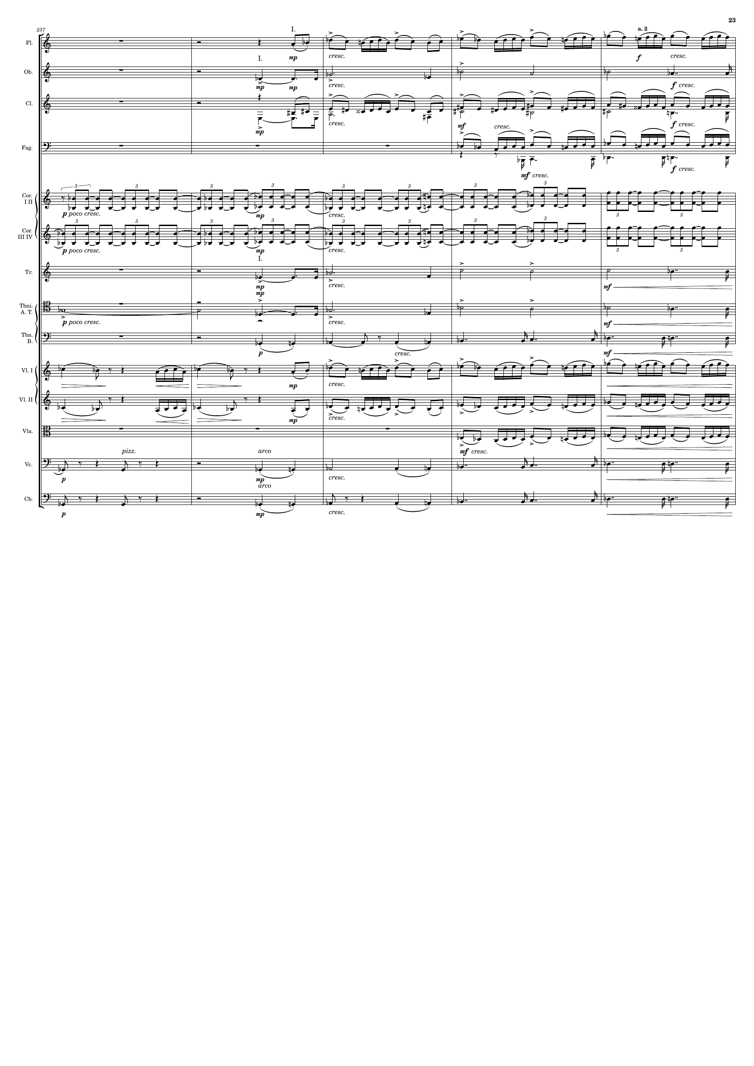
mel+rhythm
harm
mel+rhythm
mel+rhythm
rhythm
rhythm
harm
harm
harm
mel+rhythm
mel+rhythm
mel+rhythm
rhythm
harm
rhythm
harm

Slide 24
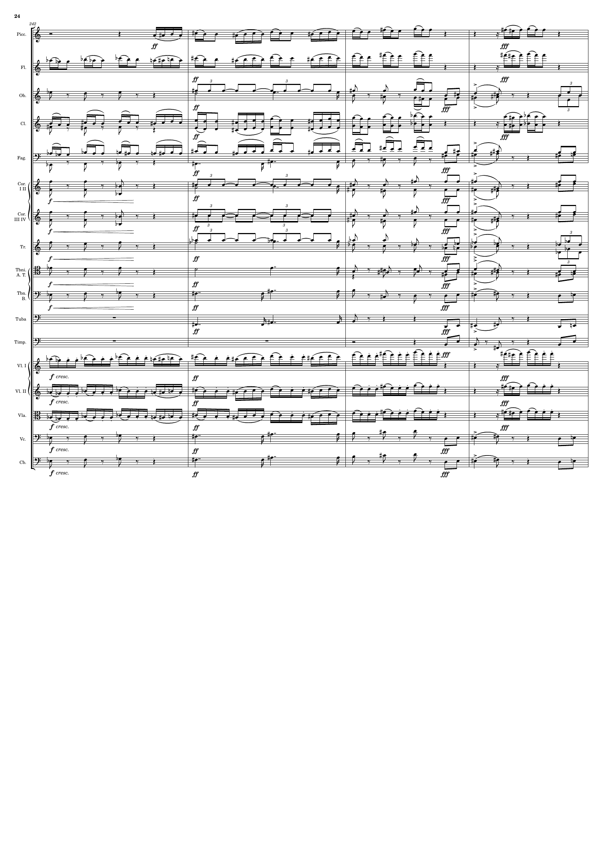
mel+rhythm
mel+rhythm
harm
rhythm
mel+rhythm
mel+rhythm
mel+rhythm
rhythm+harm
harm
rhythm
rhythm+harm
harm
rhythm
rhythm+harm
harm
rhythm
rhythm+harm
mel+rhythm
harm
rhythm+harm
mel+rhythm
rhythm+harm
harm
rhythm+harm
rhythm+harm
mel+rhythm
mel+rhythm
mel+rhythm
harm
rhythm+harm
harm
rhythm+harm

Slide 25
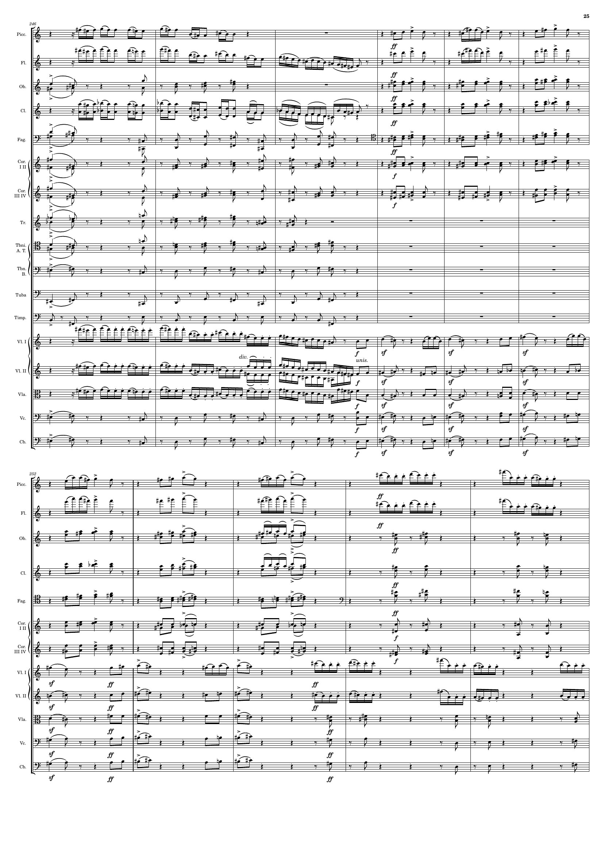
mel+rhythm
mel+rhythm
mel+rhythm
rhythm+harm
mel+rhythm
mel+rhythm
mel+rhythm
rhythm+harm
mel+rhythm
rhythm+harm
mel+rhythm
rhythm+harm
mel+rhythm
rhythm+harm
mel+rhythm
rhythm+harm
rhythm+harm
rhythm+harm
rhythm
mel+rhythm
mel+rhythm
rhythm+harm
mel+rhythm
rhythm+harm
rhythm+harm
rhythm+harm
mel+rhythm
mel+rhythm
mel+rhythm
rhythm+harm
mel+rhythm
rhythm+harm
rhythm+harm
rhythm+harm
rhythm+harm
mel+rhythm
rhythm+harm
mel+rhythm
rhythm+harm
rhythm+harm
rhythm+harm

Slide 26
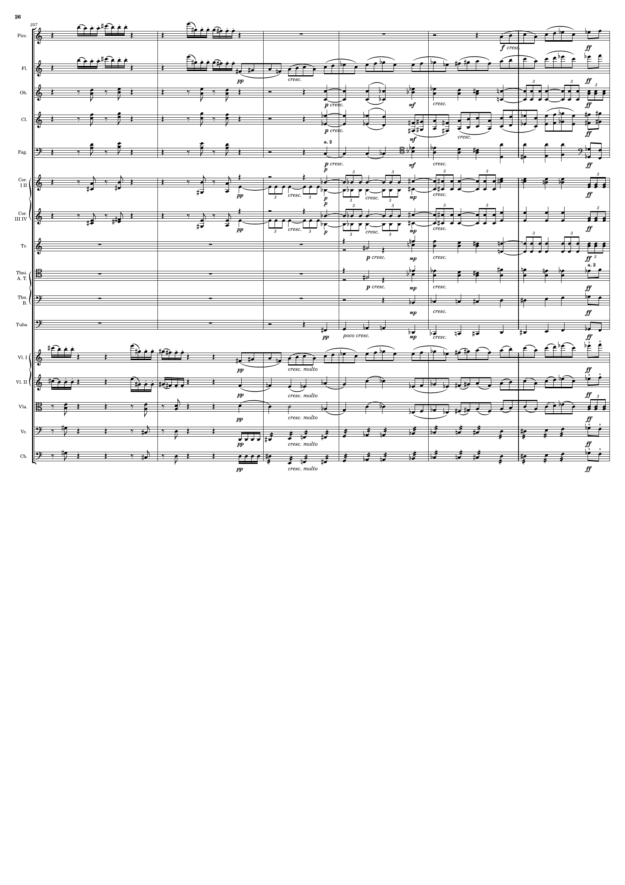
mel+rhythm
mel+rhythm
rhythm+harm
harm
rhythm
rhythm+harm
harm
mel+rhythm
rhythm+harm
harm
rhythm+harm
rhythm+harm
rhythm
rhythm+harm
rhythm
rhythm+harm
harm
rhythm
harm
rhythm
rhythm+harm
rhythm
rhythm+harm
mel+rhythm
mel+rhythm
rhythm+harm
mel+rhythm
rhythm+harm
mel+rhythm
rhythm
rhythm+harm
rhythm
rhythm+harm
rhythm+harm
rhythm
rhythm+harm

Slide 27
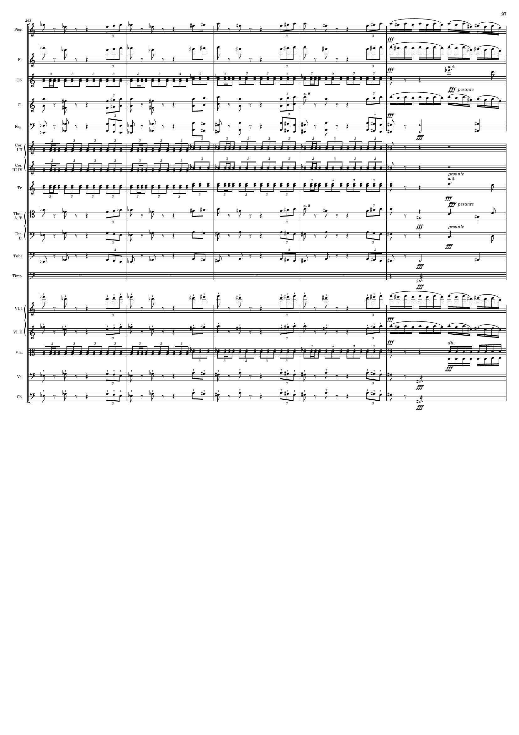
mel+rhythm
rhythm
mel+rhythm
rhythm
rhythm
mel+rhythm
mel+rhythm
rhythm
rhythm+harm
rhythm
rhythm
rhythm
rhythm
mel+rhythm
mel+rhythm
harm
rhythm+harm
harm
rhythm+harm
rhythm
rhythm
mel+rhythm
rhythm
mel+rhythm
rhythm
rhythm
rhythm+harm
rhythm
rhythm+harm
rhythm

Slide 28
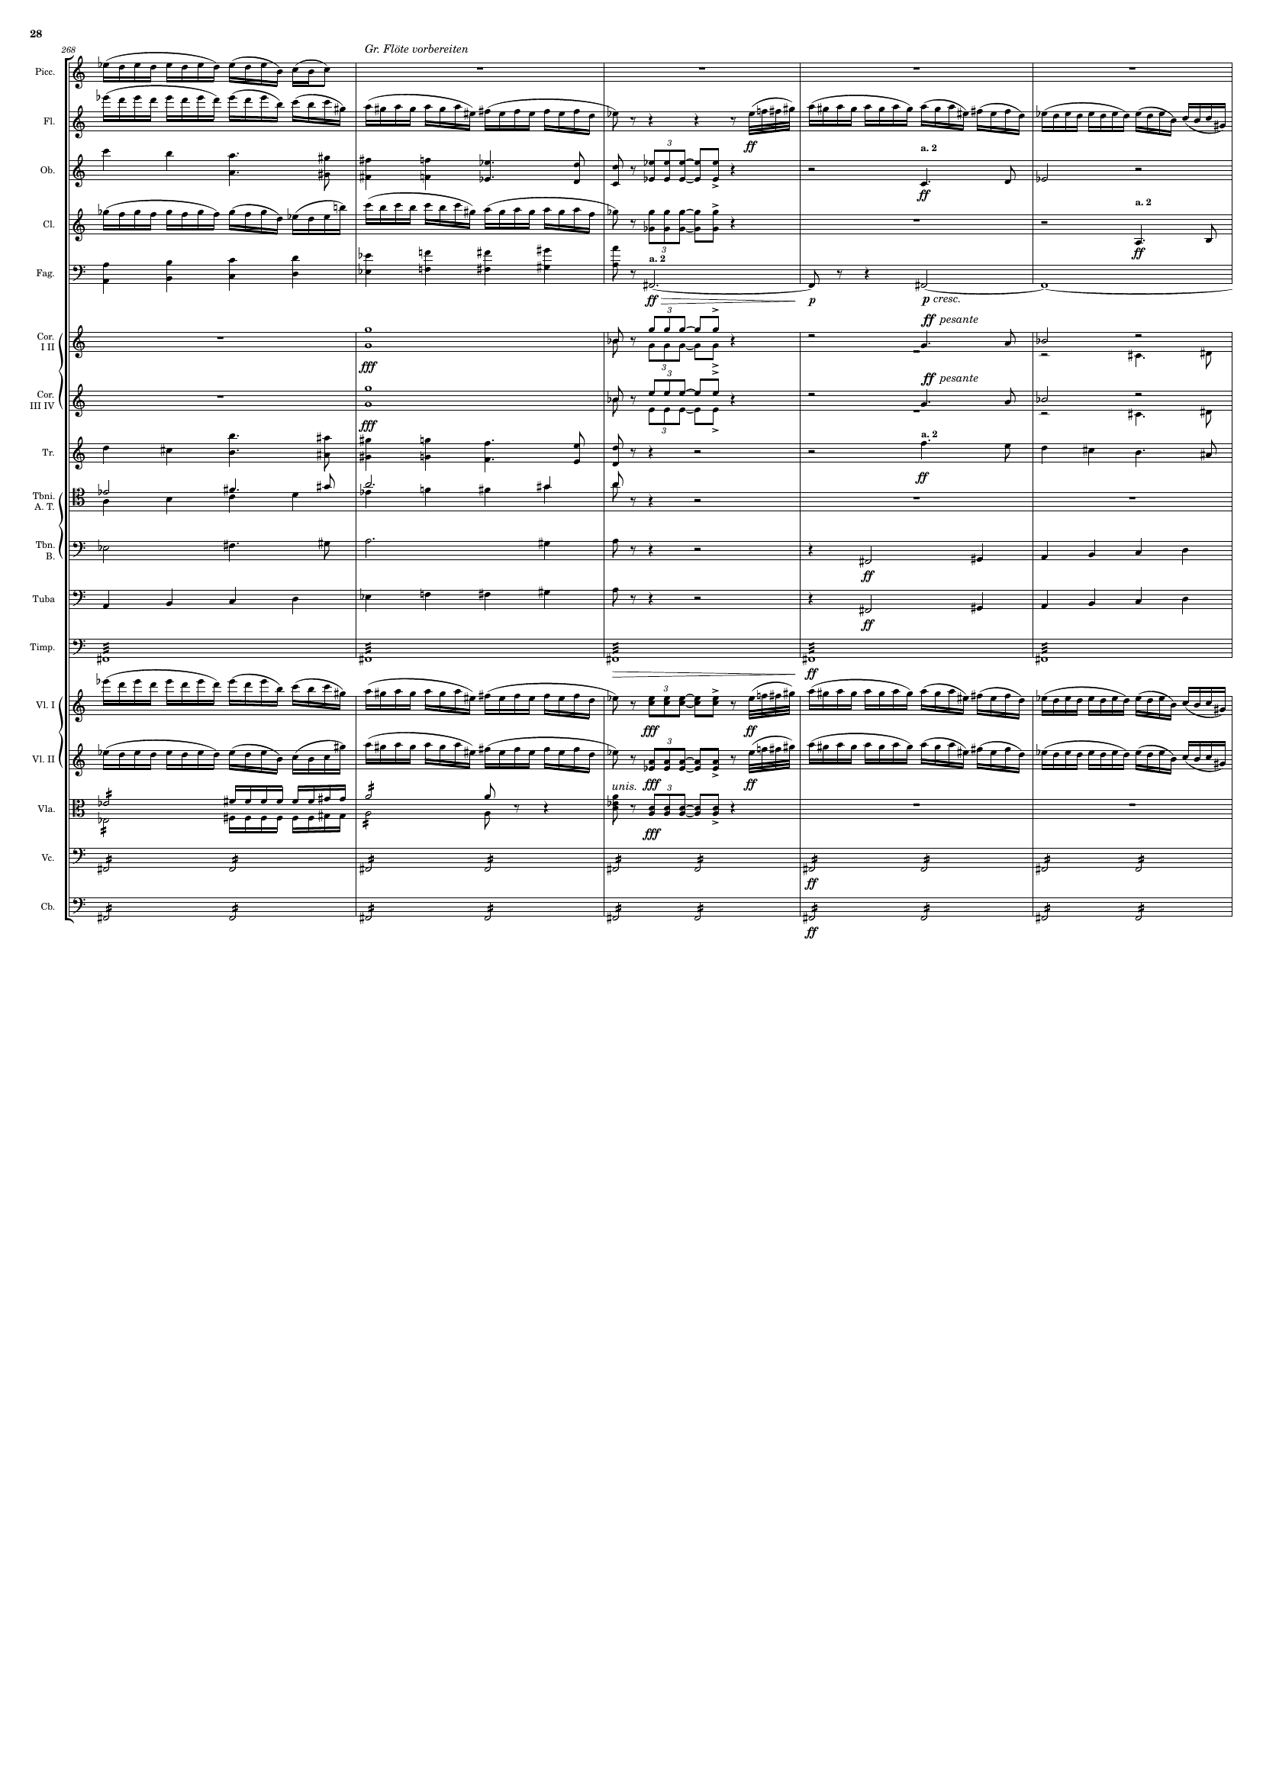
rhythm
rhythm
rhythm+harm
rhythm
rhythm+harm
rhythm
harm
rhythm+harm
harm
rhythm+harm
mel+rhythm
harm
harm
rhythm
rhythm
rhythm
rhythm
rhythm+harm
rhythm
rhythm
rhythm+harm
rhythm
rhythm
rhythm+harm
rhythm
rhythm

Slide 29
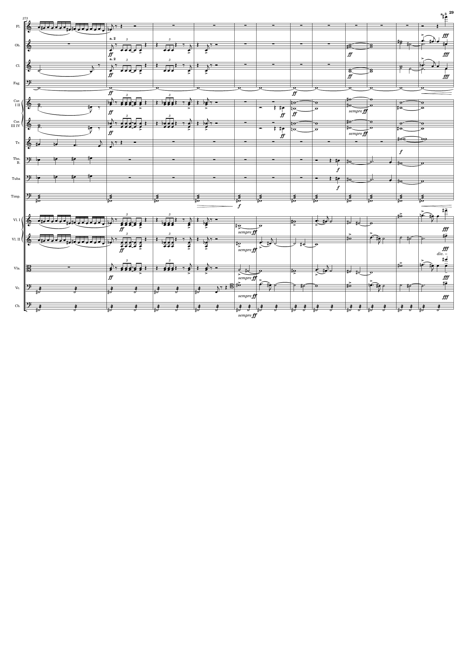
rhythm
mel+rhythm
rhythm+harm
rhythm+harm
mel+rhythm
rhythm+harm
rhythm+harm
rhythm+harm
mel+rhythm
rhythm+harm
rhythm
rhythm+harm
rhythm+harm
mel+rhythm
rhythm
rhythm+harm
rhythm
rhythm+harm
rhythm
rhythm
rhythm+harm
mel+rhythm
rhythm
rhythm+harm
mel+rhythm
rhythm+harm
mel+rhythm
rhythm
mel+rhythm
rhythm

Slide 30
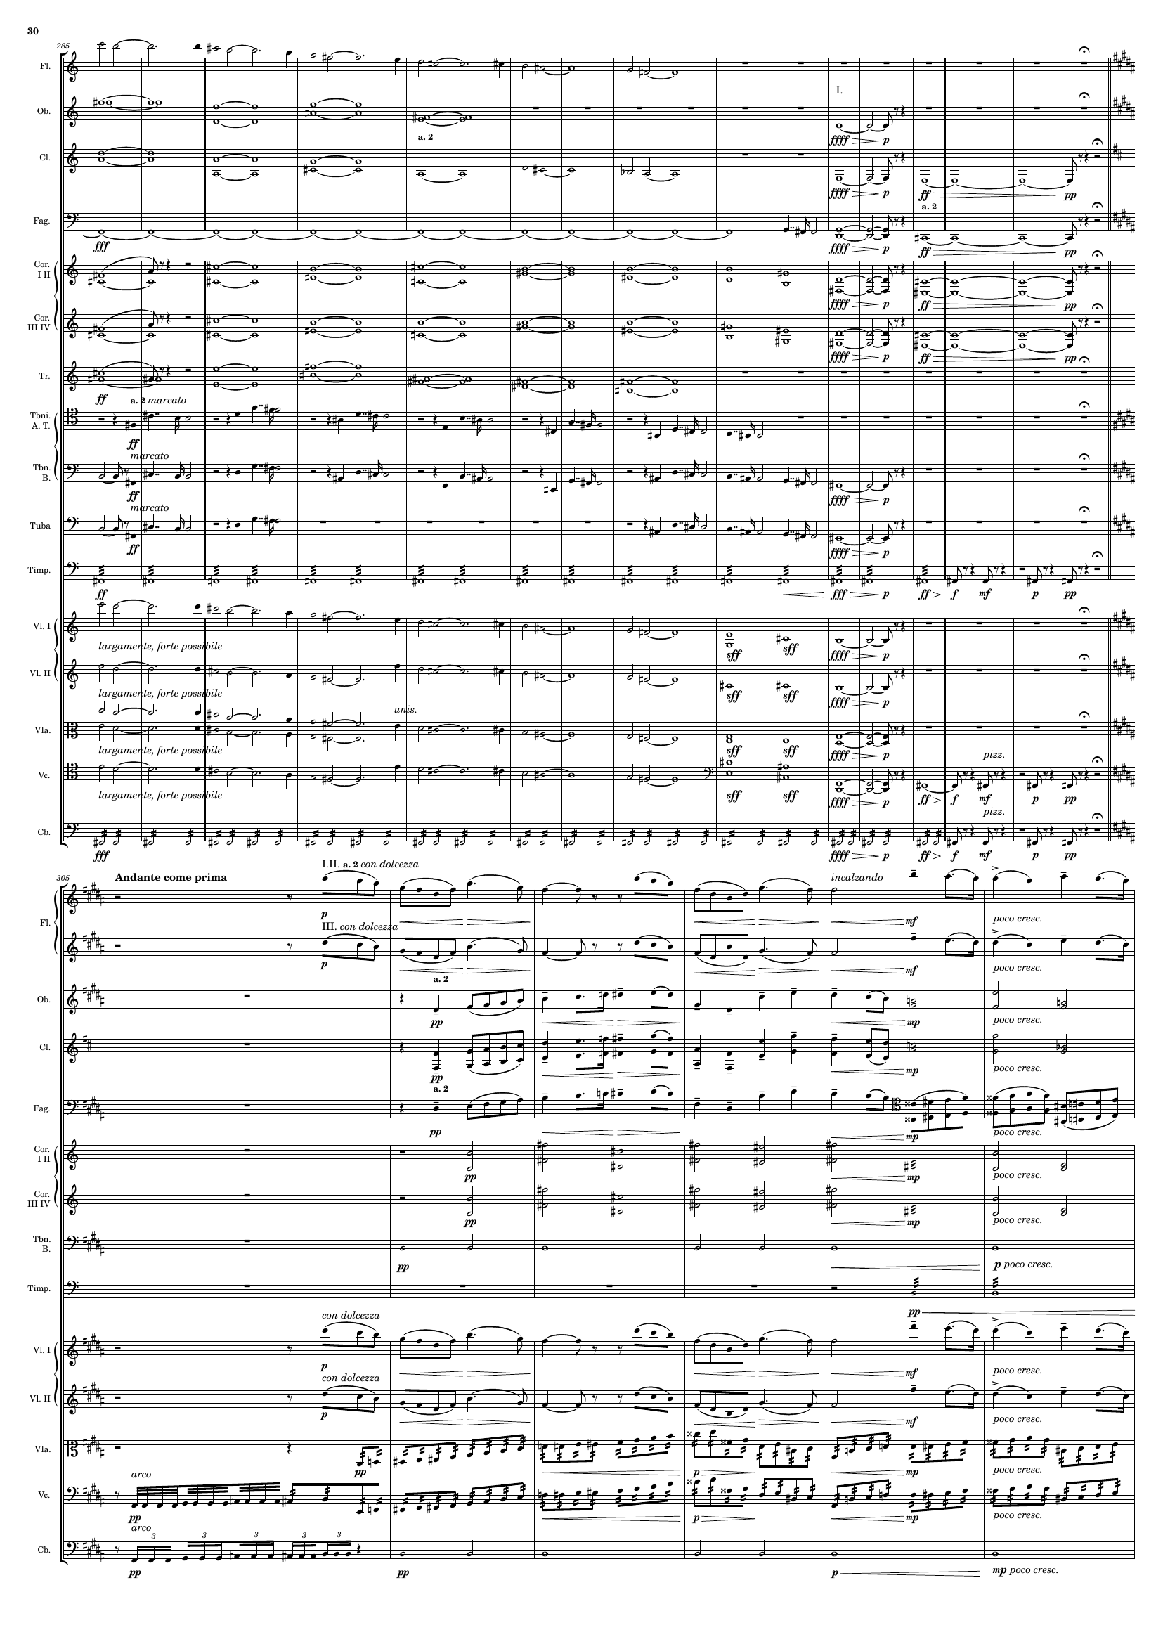
mel+rhythm
rhythm+harm
rhythm+harm
rhythm
rhythm
mel+rhythm
rhythm
rhythm+harm
rhythm
rhythm+harm
rhythm
rhythm+harm
mel+rhythm
rhythm+harm
mel+rhythm
rhythm+harm
mel+rhythm
rhythm
mel+rhythm
mel+rhythm
mel+rhythm
mel+rhythm
rhythm
rhythm
mel+rhythm
mel+rhythm
rhythm+harm
rhythm+harm
rhythm+harm
rhythm+harm
rhythm+harm
rhythm+harm
rhythm
mel+rhythm
mel+rhythm
rhythm
rhythm
rhythm

Slide 31
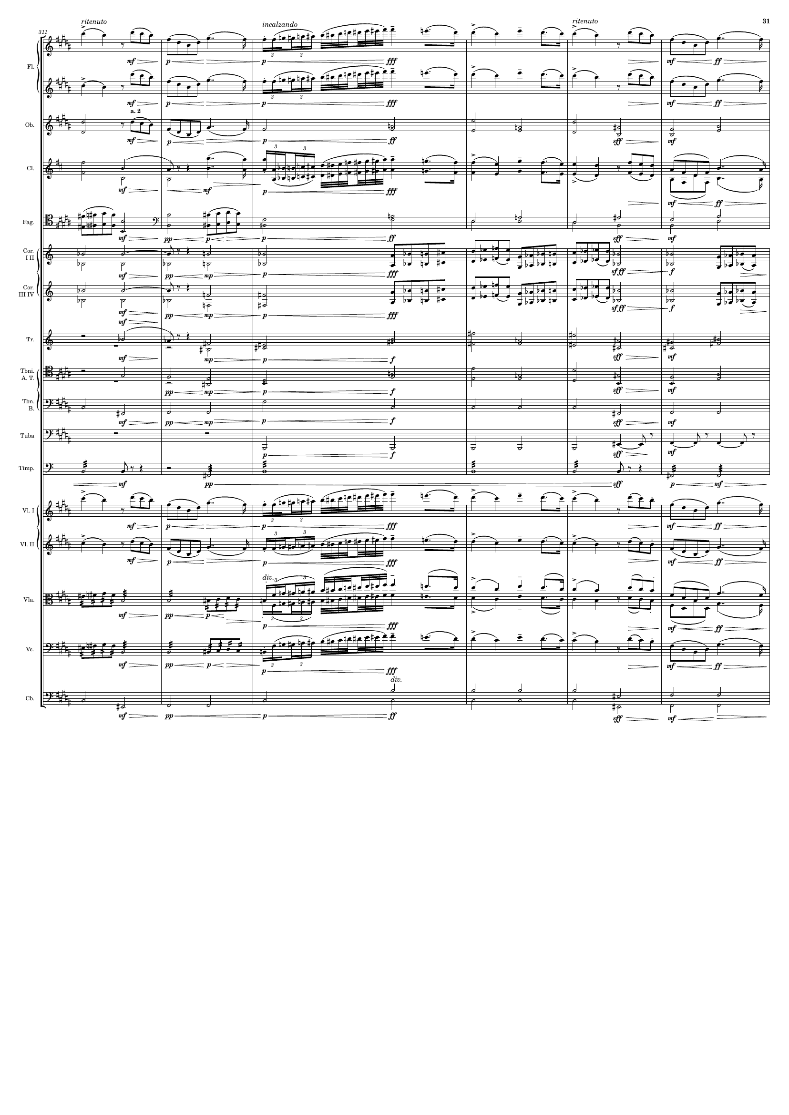
mel+rhythm
mel+rhythm
rhythm+harm
mel+rhythm
rhythm+harm
rhythm+harm
mel+rhythm
rhythm+harm
rhythm+harm
rhythm+harm
rhythm+harm
rhythm+harm
rhythm+harm
rhythm
rhythm
rhythm
mel+rhythm
mel+rhythm
rhythm
mel+rhythm
rhythm
mel+rhythm
rhythm

Slide 32
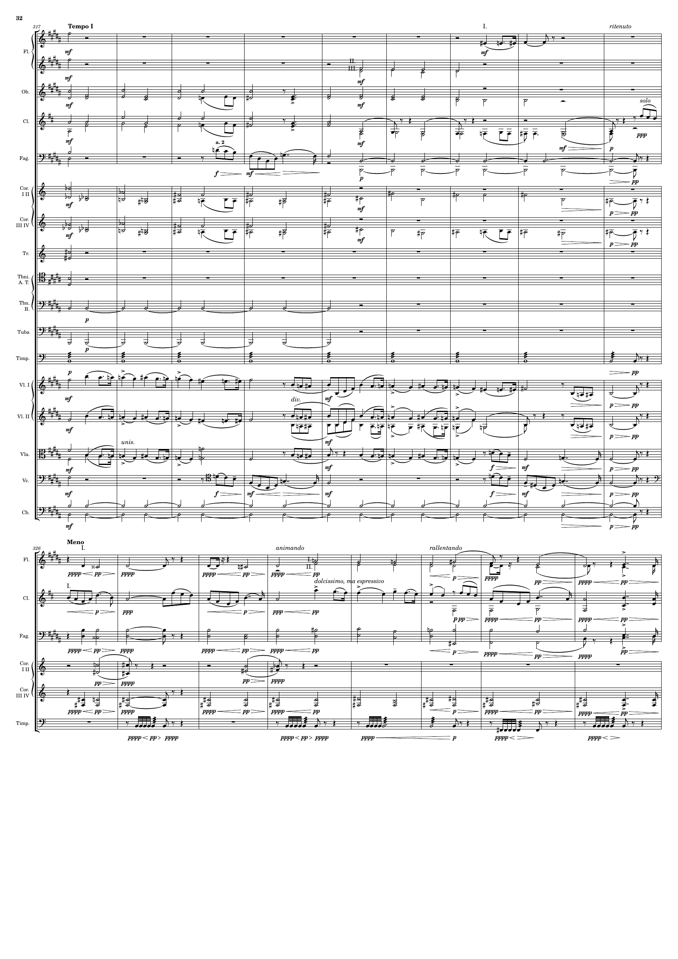
mel+rhythm
mel+rhythm
rhythm+harm
rhythm+harm
mel+rhythm
mel+rhythm
rhythm+harm
mel+rhythm
rhythm
rhythm+harm
rhythm+harm
rhythm+harm
rhythm+harm
rhythm
rhythm
rhythm
mel+rhythm
mel+rhythm
mel+rhythm
mel+rhythm
rhythm
rhythm+harm
mel+rhythm
rhythm+harm
rhythm+harm
rhythm+harm
rhythm

Slide 33
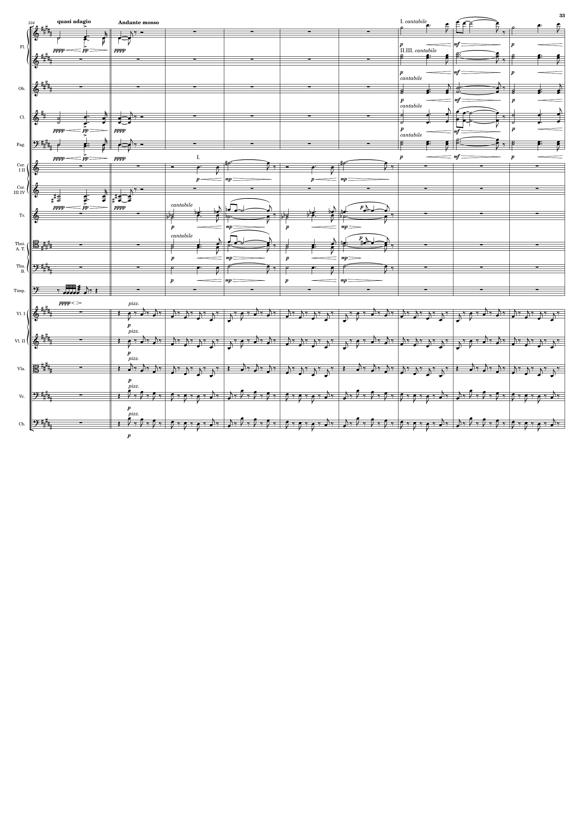
rhythm+harm
mel
rhythm+harm
rhythm+harm
rhythm+harm
rhythm+harm
rhythm+harm
rhythm+harm
rhythm+harm
mel
mel
rhythm+harm
rhythm
rhythm
rhythm
rhythm
rhythm
rhythm

Slide 34
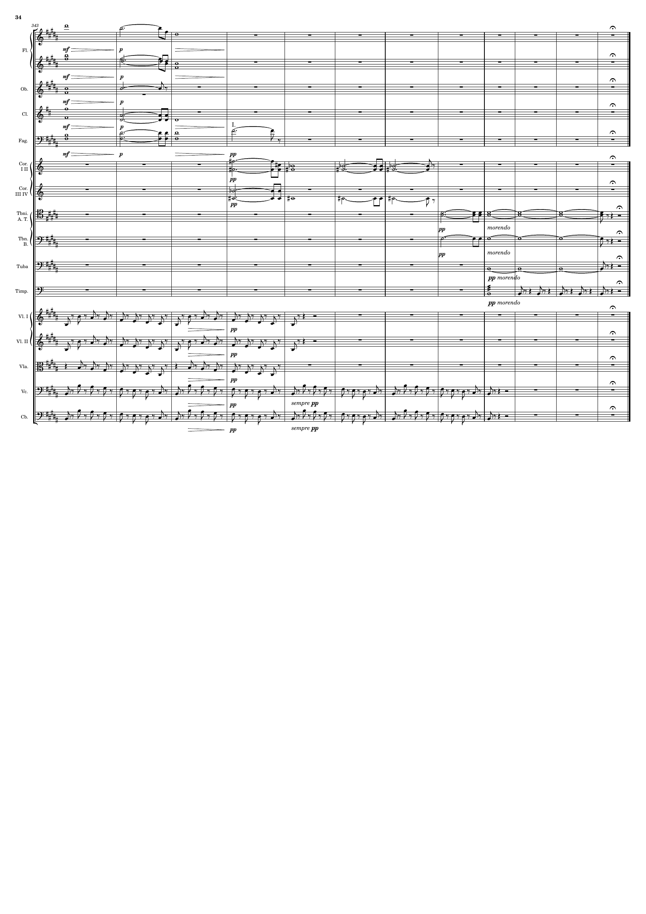
mel
rhythm+harm
rhythm+harm
rhythm+harm
rhythm+harm
mel
rhythm+harm
mel
mel
rhythm
rhythm
rhythm
rhythm
rhythm
rhythm
rhythm

